Slide 1
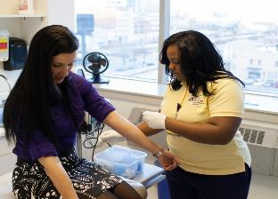
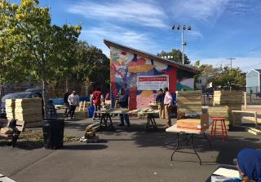
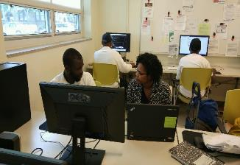

Drexel University:
An Engaged University and Anchor Partner
Activating Anchor Institutions for Building Thriving Communities in South Florida
December 11, 2017

Slide 2
UNIVERSITIES AS LOCAL PARTNERS
Place-based institution
Economic engine
Problem solver
Mission: teaching, research, and service
Educating tomorrow’s leaders
Mutual self-interest: campus and community safety and quality of life
Drexel’s future and the future of its community are inextricably linked

Slide 3
ANCHOR ROLES
Picking the “right role”
  Institutional agent
  Convener
  Facilitator
  Generalist
  Comprehensive holistic approach
  Cross sector
  Creating a front door

Slide 4
WHY WE PARTNER
Universities
Market rate housing
Rooming houses
Destination retail
Technical skills training/employment
Degree completion
Non-profit partners
Affordable housing
Single family houses
Neighborhood retail
Foundational skills, work readiness
GED completion/certificates/adult literacy

Slide 5
GOAL: AN ENGAGED SYSTEM
Anchor administrative investments
Anchor knowledge/research expertise
Residents
Civics and grassroots non-profits
Community and City non-profits
Government and City agencies
School District
Funding community

Slide 6
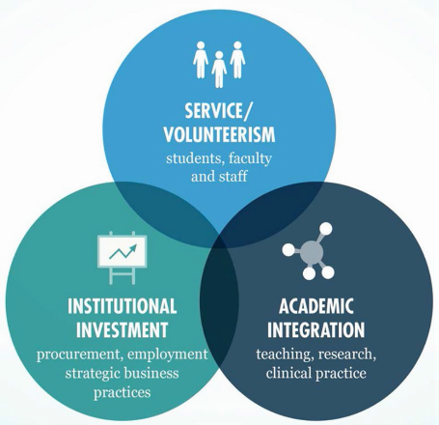
DREXEL’S THREE DIMENSIONS OF CIVIC ENGAGEMENT: A PLACE-BASED STRATEGY
Student and Employee Volunteerism
Drexel offers high-quality, community-based volunteer opportunities through the Lindy Center for Civic Engagement, open to all Drexel students, faculty and professional staff.
Academic Integration
Our faculty explicitly integrate civic engagement into research, coursework and clinical practice. Our academic programs allow our students to solve problems on the ground, interacting with residents, neighboring schools, community service agencies, and local businesses.
Institutionally Supported Neighborhood Investment
Drexel serves as an anchor institution in West Philadelphia, investing fully in the community through hiring and procurement, and supporting initiatives to improve the economic opportunity in the surrounding neighborhoods.
Notes:
laid out the 3 dimensions
My role to integrate across these dimensions
Drexel unusual in that there is much less split between academic and administrative; we function as a whole

Slide 7
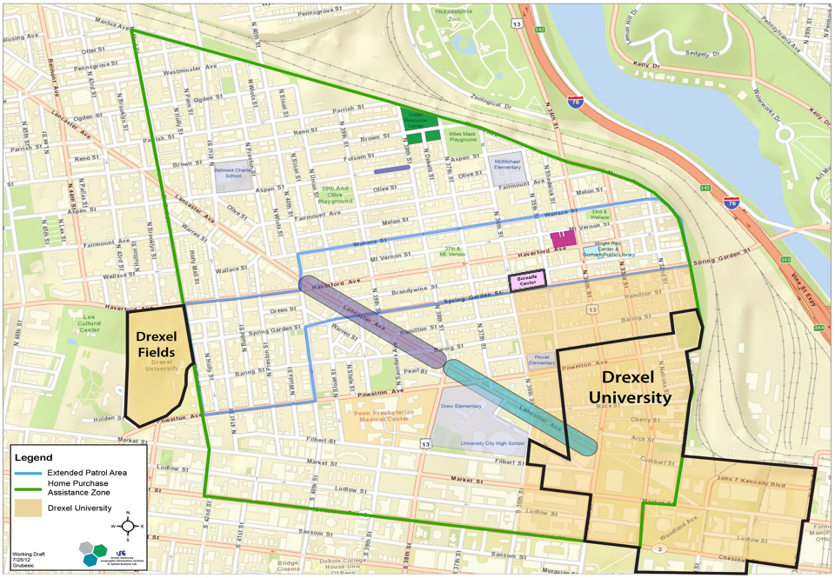

Slide 8
OFFICE OF UNIVERSITY & COMMUNITY PARTNERSHIPS
President
Provost
Faculty Fellow
Civic Engagement
Vice Provost
University and Community Partnerships
Trustee Community Partnerships Committee
University and Community Partnerships
Lindy Center
Neighborhood
Initiatives
Citywide Initiatives
Community Based Learning
Dornsife Center
Economic
Development
Education
Digital On-Ramps
Civic Leadership
Partnerships
Workforce Development
Early Childhood
KEYSPOT
Community
Partnerships
Program Management
Construction
K-12
STEAM
Public Service
Facilities Management
Procurement
SLAMS

Slide 9
INSTITUTIONALIZING ACADEMIC AND STUDENT ENGAGEMENT
Lindy Center for Civic Engagement focuses on student civic leadership, community-based learning, public service and community partnerships, and supports students, faculty, and professional staff.
Dornsife Center for Neighborhood Partnerships, Drexel’s “urban extension center” in the neighborhood connects the community to University expertise, from a community lawyering clinic, a health and wellness HUB, nutrition and healthy cooking instruction, open computer access, small business supports, arts and culture programming, a Writers Room, and more.
Faculty Committee for Civic Engagement brings faculty members from all colleges and school together to understand and build pathways for integrating civic engagement into Drexel’s academic mission.
Lindy Institute for Urban Innovation forges innovative strategies to equitably advance cities, drawing inspiration from Drexel’s commitment to civic engagement and experiential education to train the next generation of urban leaders. In 2017 it introduced a new Masters of Science in Urban Strategy.

Slide 10
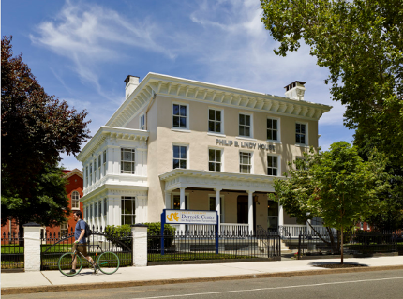
DORNSIFE CENTER FOR NEIGHBORHOOD PARTNERSHIPS
Goals:
Place for academic, student, institutional engagement
Implement comprehensive strategy
Engage nonprofit partners
Guidance by Community Advisory Council
Solution centered
Foster dialogue
Program Areas Include:
Community Lawyering
Health and Wellness
Adult Education and Job Training
Collaborative Art and Performance
Home Preservation
STEM Education
Local Entrepreneurship
Community Meetings
Defining a new model of urban extension for a private urban university.
1.3 Acre Site in Mantua
Opened June 2014

Slide 11
JOBS TODAY, JOBS TOMORROW
Careers
Small Business Support
College Access/
High School Mentoring
High School
College
Middle School Mentoring
Education K-8
Powel
SLAMS
Pre K
Head Start
Certificate
&
Apprentice
Training
0-3
Early Childcare
Helms Academy
Education K-8
McMichael
Job Pipeline Program
Career Exposure
Experience
Immersion
After School Experiences
Parent Programming & Outreach

Slide 12
DREXEL UNIVERSITY – CONCURRENT DEVELOPMENT PROJECTS
Notes:
What is the bid idea?
Keith's slide.
Footprint of innovation; great growth and potential

Slide 13
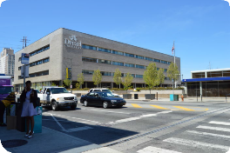
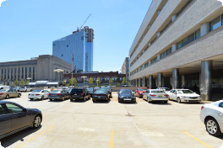
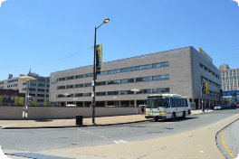
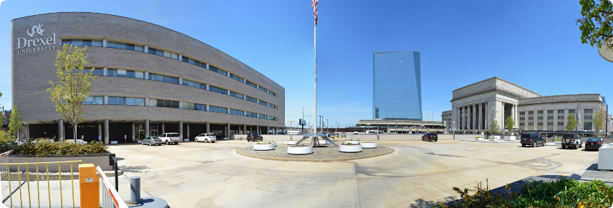
DREXEL SQUARE
Drexel Square: Existing Conditions

Slide 14
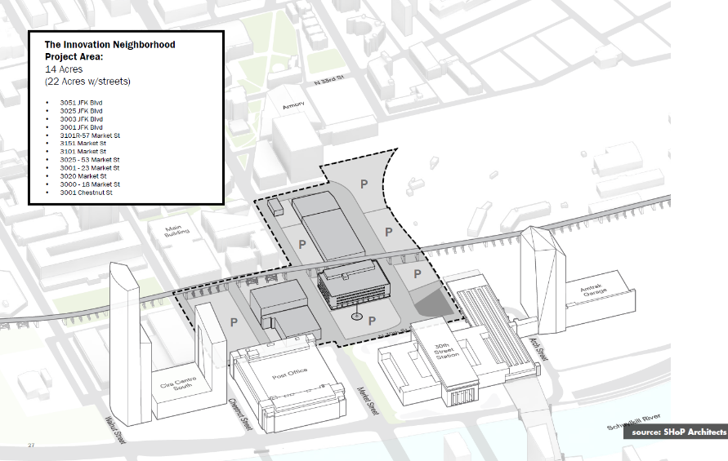
EXISTING SITE

Slide 15
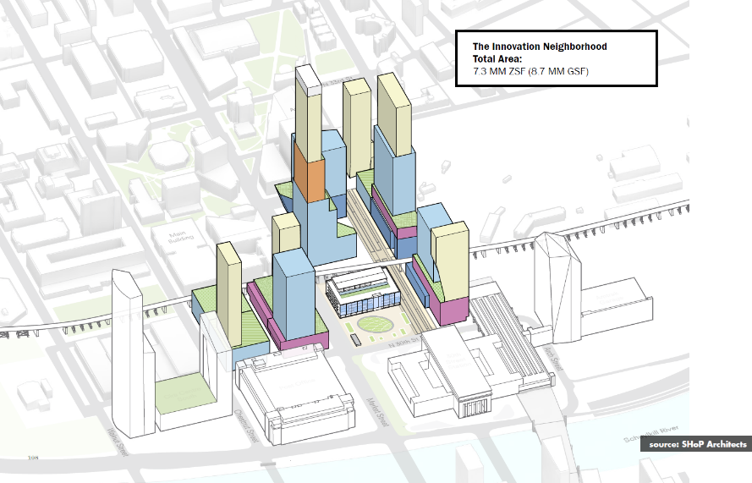
OVERALL MASSING

Slide 16
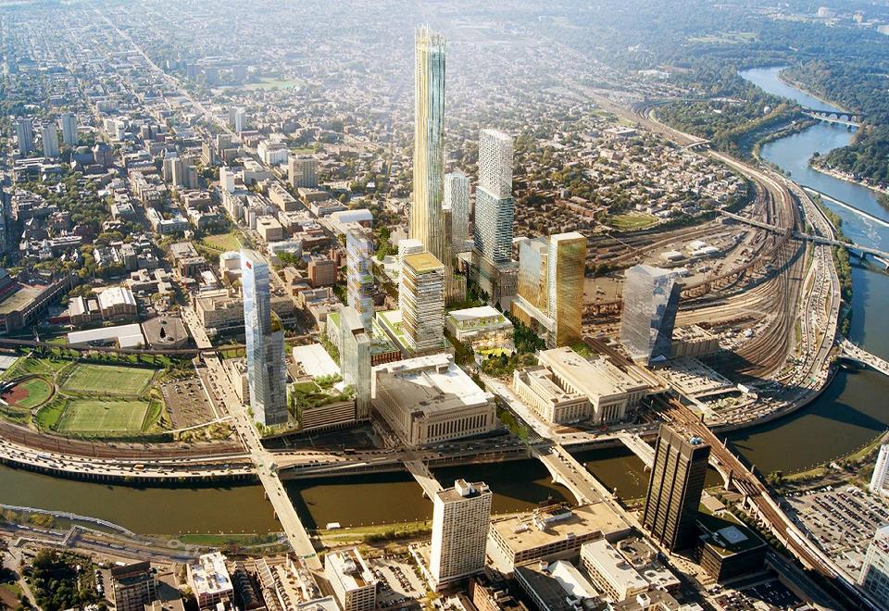
source: SHoP Architects

Slide 17
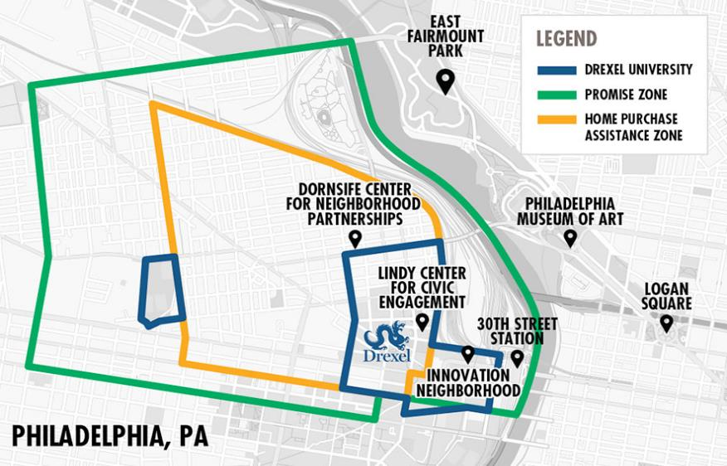
West Philadelphia promise zone
Notes:
We are part of the Philadelphia Promise Zone, so part of the larger context there.

Slide 18
MEETING AN URGENT LOCAL NEED
The West Philadelphia Promise Zone is characterized by deep and persistent poverty…
POVERTY
RATE
48%
UNEMPLOYMENT
RATE
15%
MEDIAN HOUSEHOLD INCOME
$21,000
24% OF RESIDENTS LACK A HIGH SCHOOL DIPLOMA
66% OF RESIDENTS HOLD A HIGH SCHOOL DIPLOMA OR GED
20% HAVE AN ASSOCIATES DEGREE OR HIGHER
…With profound education disparities…
…And an intractable wage gap. 62% of Promise Zone jobs pay more than $3,333 per month, but…
ONLY 32.6% OF RESIDENTS EARN AT THIS LEVEL
OVER 67% OF RESIDENTS EARN LESS THAN $3,333 PER MONTH
23.7% OF RESIDENTS EARN LESS THAN $1,250 PER MONTH

Slide 19
INNOVATION ECONOMY PARADOX
New jobs created ... but continuing high unemployment in local neighborhood
New residents and increasing homeownership … but loss of affordability and displacement of existing homeowners
Increased business opportunities … but neighborhood corridor retail is stagnant
New focus on urban living … but neighborhood tension and discomfort

Slide 20
Institutionalizing Economic Inclusion
Hire Local for employment and contracted services, including a commitment to local employment and business participation by Drexel’s strategic business partners, with adult education and targeted job training.
Adult Education through a suite of offerings at the Dornsife Center, from adult basic to GED and the Helms Academy, a new adult high school with Goodwill Industries and CCP, and extensive digital access and training
Buy Local in purchasing and contracting, through an analysis of Drexel’s procurement system and a focus on building businesses in the seven West Philadelphia zip codes.
Build Local in Drexel projects, through a contracted partnership with a construction manager responsible for high goals for participation and a neighborhood branch office to facilitate local employment, foster apprentice development, and encourage local business.
Notes:
Depends on changing our business practice, as well as our policies and approach
Significant institutionalization in past 5 years

Slide 21
Economic Inclusion: Hire Local
Over 12% of professional staff are local residents
Average salary paid to West Philadelphia faculty/staff is approximately $62,000
There were 80 new hires from West Philadelphia in FY17, nearly tripling the FY16 total of 30
215+ job connections made through the Beachell Family Learning Center in 3 years
40+ Philadelphia youth placed in Drexel internships annually
The number of local residents employed by Drexel has reached an all time high with the University operating job-training programs for positions at the University and with its contractors.
Data and analysis
Drexel positions and job pipelines
Vendor job training programs
WorkReady youth internship program
Adult Education Suite at Dornsife – cradle to career programs meet residents where they are
Notes:
Data – through a partnership with human resources we are currently pulling the following data to gain an understanding of human capital patterns and the job interests of West Philadelphians:
-most posted positions
-most terminated positions
-positions most commonly applied to by West Philadelphians
-job category of local residents (administrative, facilities, professional, etc.) and average wage of local residents
-number of local residents employed at Drexel
By examining this data we are able to determine positions that are of interest to local residents (most commonly applied to positions) and areas where trained employees might be beneficial to the university. By leveraging dollars from the public workforce system we are able to run customized trainings at a fraction of the cost.
Adult Education @ Dornsife – Adult Basic Education → GED Prep → Helms → Career

Slide 22

ECONOMIC INCLUSION: ADULT EDUCATION
Beachell Family Learning Center at the Dornsife Center
3 fully staffed computer labs where residents can build computer skills, get job search support, and access educational programs that are designed to meet them where they are
Over 20,000 visits in 3 years, about 500 visits per month
51 students enrolled in Helms Academy
14 students have advanced 2 or more grade levels
135 CCP credits earned to date
5 residents have graduated with their high school diploma

Slide 23
Economic Inclusion: Buy Local
$46+ million spent with women and diversity-owned businesses in 2016
26% of Drexel purchase from diversity vendors in 2016
Spend with women and diversity-owned businesses jumped 185% from FY15 to FY16
Drexel has taken a strategic, intentional approach to economic inclusion that informs the way the University purchases, contracts, and supports local businesses.
Phase 1 - “demand-side” analysis of Drexel’s spend
Phase 2 - “supply side” analysis and creation of an inventory of local businesses within specific target commodities
Phase 3 – Business Practice Alignment
  Transparent on-boarding and community outreach
  Dedicated Director and Strategic Sourcing Specialists
  RFP language and policy
Notes:
Data – through a partnership with human resources we are currently pulling the following data to gain an understanding of human capital patterns and the job interests of West Philadelphians:
-most posted positions
-most terminated positions
-positions most commonly applied to by West Philadelphians
-job category of local residents (administrative, facilities, professional, etc.) and average wage of local residents
-number of local residents employed at Drexel
By examining this data we are able to determine positions that are of interest to local residents (most commonly applied to positions) and areas where trained employees might be beneficial to the university. By leveraging dollars from the public workforce system we are able to run customized trainings at a fraction of the cost.
Adult Education @ Dornsife – Adult Basic Education → GED Prep → Helms → Career

Slide 24
ECONOMIC INCLUSION: CONNECTING TO THE ACADEMIC MISSION
Coursework offered by LeBow College of Business and Close School of Entrepreneurship
  Technical assistance for local business from Kline School of Law, LeBow College of Business, and the Close School
  Consulting class worked with local businesses to develop business plans
Undergraduate co-ops supported business in implementing business plans
Follow-up consulting course used student spend data to develop a communication plan to encourage students to spend locally
Walking tour of local businesses during new student orientation

Slide 25
Economic Inclusion: Build Local
5
Mantua residents have been hired by Bittenbender in year 1
10
West Philadelphia residents hired
46% of all Bittenbender contracts are with women or diversity-owned businesses
In addition to complying with all Economic Opportunity Plans, the University has sought creative solutions to maximize the local economic impact of all construction projects.
Bittenbender Construction partnership
Pre-Apprenticeship program in development
Uniform data tracking across all construction projects
Economic inclusion language in all RFP’s and contracts

Slide 26
JOBS TODAY, JOBS TOMORROW
Careers
Small Business Support
College Access/
High School Mentoring
High School
College
Middle School Mentoring
Education K-8
Powel
SLAMS
Pre K
Head Start
Certificate
&
Apprentice
Training
0-3
Early Childcare
Helms Academy
Education K-8
McMichael
Job Pipeline Program
Career Exposure
Experience
Immersion
After School Experiences
Parent Programming & Outreach

Slide 27
BENEFITS OF ENGAGEMENT
Financial savings resulting from use of on-the-job training dollars, improved retention, reduction in dollars paid to temp agencies
Employees who are prepared for their positions and provided with tools to build careers
Strategic analysis of existing business practices, increasing overall efficiency through collaboration
Strong and dependable business partners
Increased access to additional philanthropic resources
Increased economic stability in the neighborhoods surrounding the university
Political support
Market differentiator for socially-conscious potential students, faculty, staff, trustees
Enhanced teaching and research
Enhanced institutional brand, fulfilled social mission
Increased visibility with key stakeholder groups
Institutional culture that takes pride in a locally engaged role

Slide 28
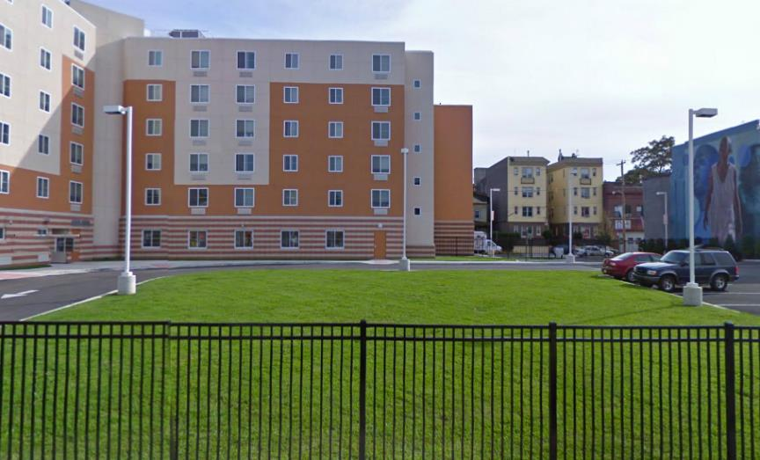
ACADEMIC ENGAGEMENT IN ACTION
COMMUNITY BASED DESIGN-BUILD: BEFORE

Slide 29
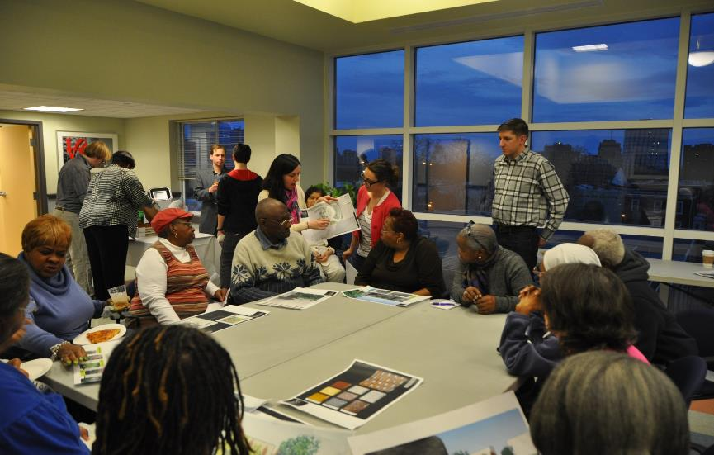
COMMUNITY ENGAGEMENT

Slide 30
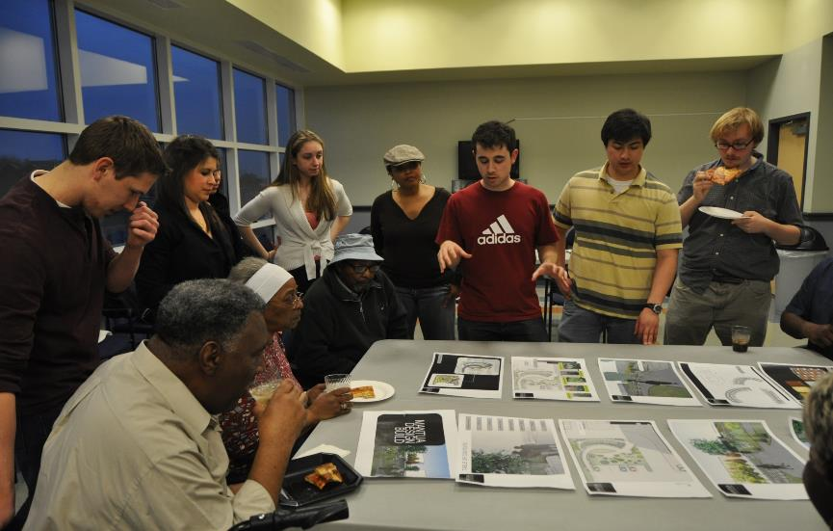
COMMUNITY ENGAGEMENT

Slide 31
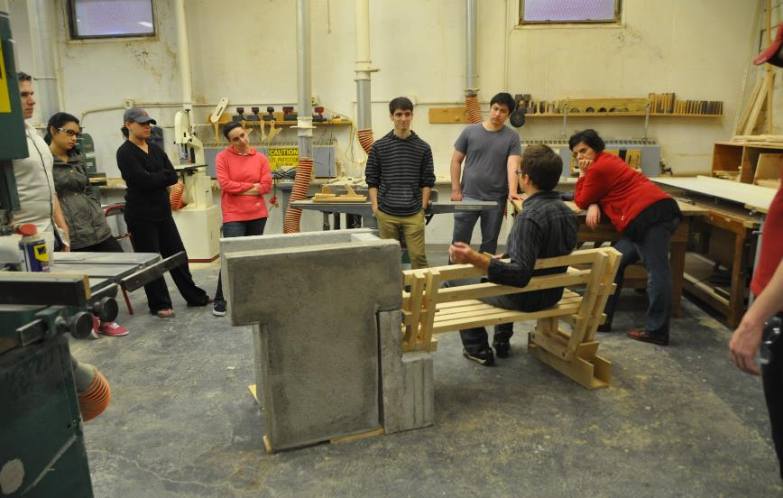
EXPERIENTIAL LEARNING: HANDS-ON DESIGN

Slide 32
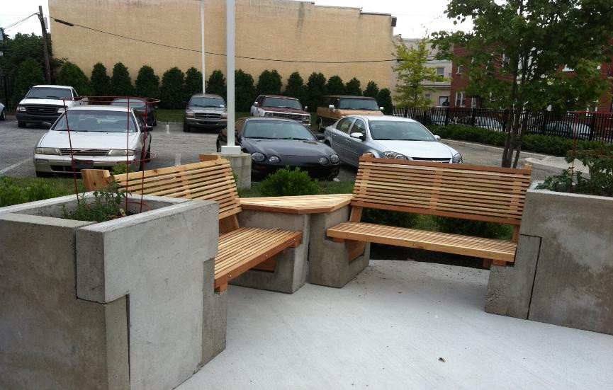
IN PLACE

Slide 33
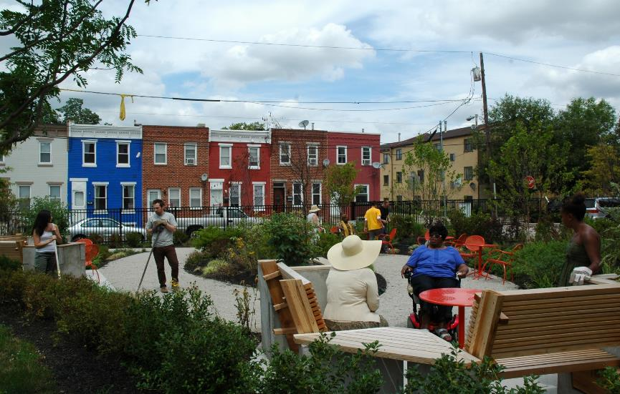
COMMUNITY BASED DESIGN-BUILD: AFTER

