Slide 1
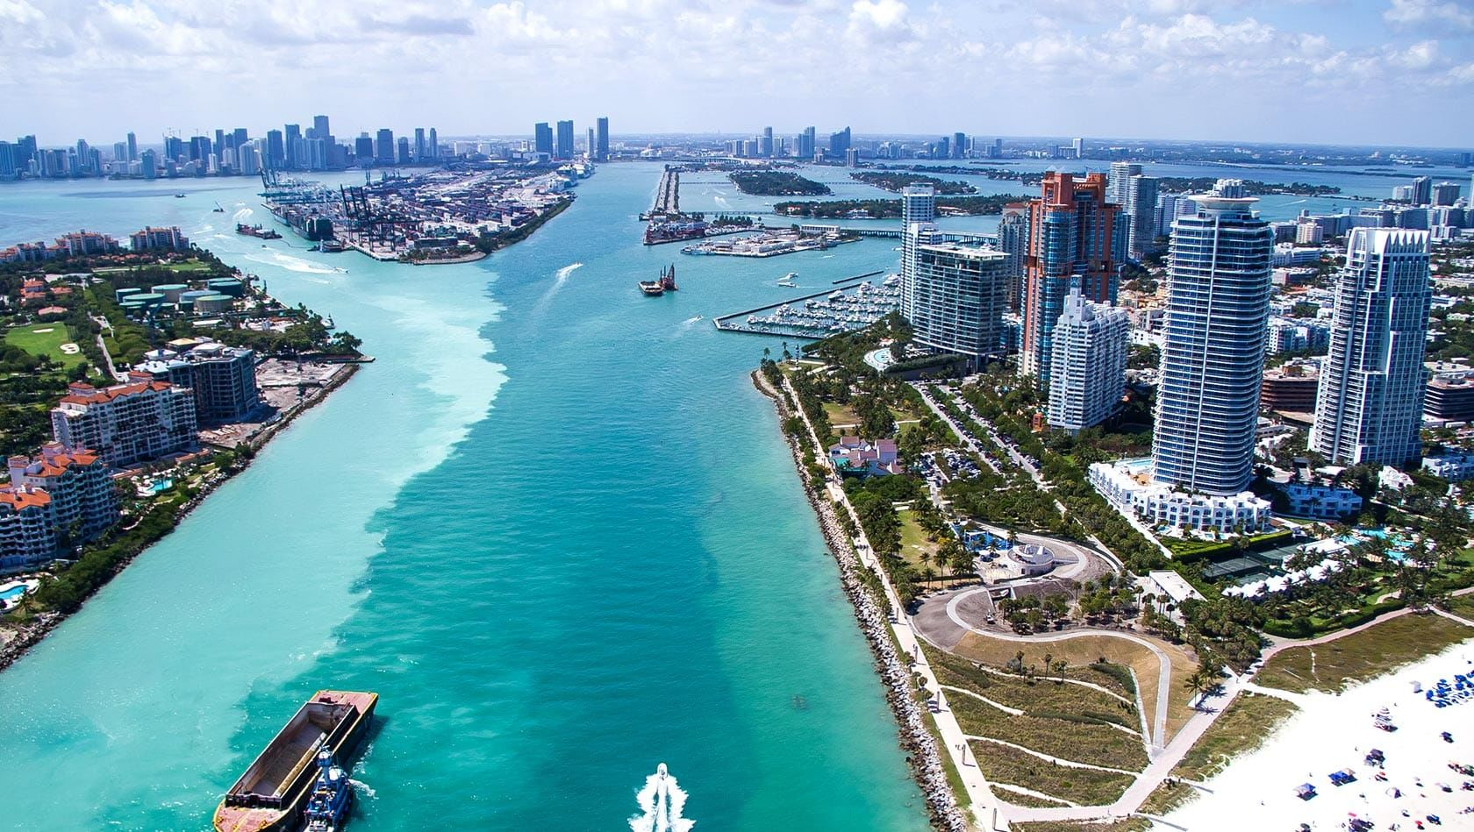

Community Wealth Building in South Florida
Leveraging institutional power to
build community wealth
Notes:
Introduction

Slide 2

The importance of asset-based approaches
Income can start and stop.
Income is subject to the whims of others.
Assets create security and stability.
It takes a job to get out of poverty, but it takes assets to stay out of poverty.
When families possess assets – skills, social networks, a home, savings, an ownership stake in a business – they are better able to withstand shocks like unemployment or illness, to send a child to college, to plan for the future.

Slide 3
Community Wealth Building
A systems approach to economic development built on locally rooted and broadly held ownership…
… So that reliable new outcomes
– equity, inclusion, economic stability, resilience –
are produced as a natural consequence of the functioning of the economy…

Slide 4




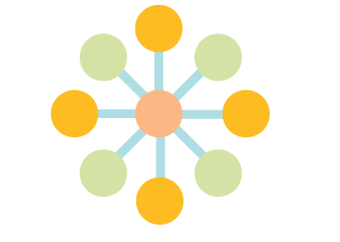


Drivers of Community Wealth Building
Promotes local, broad-based ownership as the foundation of a thriving economy
Encourages institutional buy-local strategies to keep money circulating locally
Develops under-utilized local assets of many kinds for benefit of local residents
PLACE
OWNERSHIP
MULTIPLIERS
Links training to employment and focuses on jobs for those with barriers to employment
Develops institutions and supportive ecosystems to create a new normal of economic activity
Brings many players to the table: nonprofits, anchors, philanthropy, and cities
COLLABORATION
WORKFORCE
SYSTEM
Aims to create inclusive, living wage jobs that help all families enjoy economic security
INCLUSION
Notes:
Community wealth building is driven by the following attributes. Rather than traditional forms of economic development that might rely on corporate attraction, community wealth building seeks to develop local assets, for the benefit of local residents. For more information about community wealth building, see: http://democracycollaborative.org/cities

Slide 5
Community Wealth
Building Ecosystem
Notes:
Community wealth building strategies are designed as a self-supporting ecosystem, that leverages the economic power of anchor institutions (like health systems and hospitals) to drive local and shared ownership, which in turn fuels individual asset building. It is this type of financial security that will begin to shift the social determinants of health. For more information about community wealth building strategies see: http://democracycollaborative.org/cities

Slide 6
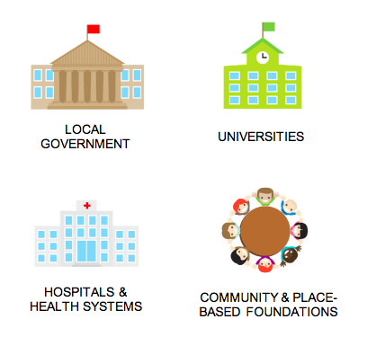
What are anchor institutions?
Nonprofit or public institutions
Rooted in place- “sticky capital”
Economic engines- large purchasers, employers & investors
LOCAL GOVERNMENT
UNIVERSITIES
HOSPITALS &
HEALTH SYSTEMS
COMMUNITY & PLACE-BASED FOUNDATIONS
Notes:
An important component of the systems aspect of community wealth building is leveraging the sizable power of anchor. Anchor institutions are nonprofit or public institutions that are firmly rooted in their locales, including hospitals, universities, local governments, and utilities. These institutions often have a social or charitable purpose, and unlike for-profit corporations that can relocate, are place-based and tend to stay put. As such, they have a vested self-interest in helping to ensure that the communities in which they are based are safe, vibrant, healthy, and stable.
For more information about anchor institutions, see: http://democracycollaborative.org/content/anchor-dashboard-aligning-institutional-practice-meet-low-income-community-needs

Slide 7
“Eds and Meds” Economic Impact
Employment | 9 million+
Annual Expenditures | $1.2 trillion+
Annual Procurement | $500 billion+
Investment Portfolios/Endowments | $750 billion+

Slide 8
The Anchor Mission
A commitment to intentionally apply an institution’s long-term, place-based economic power and human capital in partnership with community to mutually benefit the long-term well-being of both.
Notes:
Hospitals and health systems can adopt an anchor mission to begin to address the upstream determinants of health. In effect, the leading health organizations are moving along a progression from: 1) doing good things for the community; to 2) intentionally addressing social determinants of health and measuring and reporting on the impact they are having in addressing community challenges; to 3) recognizing that their institutions must be accountable for all of their impacts on community health, and leveraging all of their assets to ensure the well-being of the community in which they are based.
For more information about the anchor mission of healthcare, see: Tyler Norris and Ted Howard, Can Hospitals Heal America’s Communities? “All in for Mission” is the Emerging Model for Impact (Takoma Park, MD: The Democracy Collaborative, 2015)

Slide 9
Applying All Assets for Health
We can leverage many of our activities in key functional areas to understand the economic, environmental and social impacts.
Health Care Services
Procurement & Supply
Treasury
Environmental Stewardship
Technology
Total Health Impact
National Facility Services
Human Resources
Communications
Research
Government Relations
Community Benefit
Labor Mgmt Partnership
Notes:
Physical & Mental Health Care
“Body, Mind and Spirit”
Individual/Family Home/School/Worksite Neighborhood/Community Society
Purchasing / Procurement / Sourcing
Supplier Diversity ($1.3B with women & minority-owned firms)
National Facility Services (80 million sq. feet + surrounding area)
Environmental Stewardship (materials, energy, toxics)
Workforce Development – diversity & inclusion, pipeline , professional societies, training programs, youth potentiation
Community engagement / volunteerism (180,000 employees)
Charity Care and Coverage – Medicaid expansion
Health in all policies – engage physicians
Grant portfolio
Social Impact Investing (PRI / MRI)
Social well-being (violence prevention, community building, housing, transportation….VIA PARTNERSHIP)

Slide 10
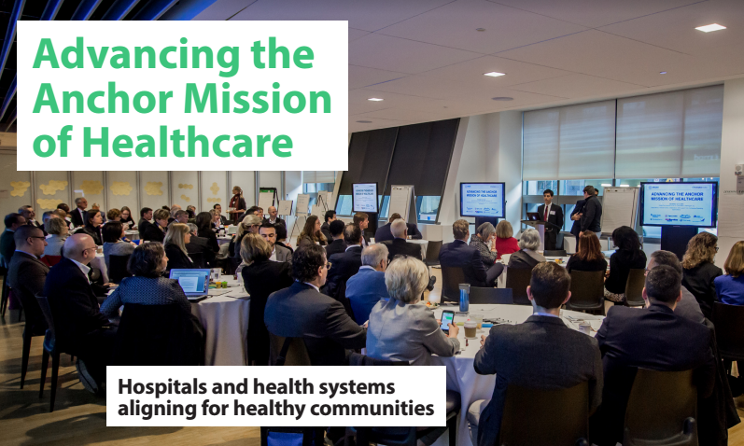

Slide 11
Healthcare Anchor Network participants
Notes:
Logos reflect current members as of July 2017. For more information about how to join, see: https://www.healthcareanchor.network/join-the-network.html

Slide 12
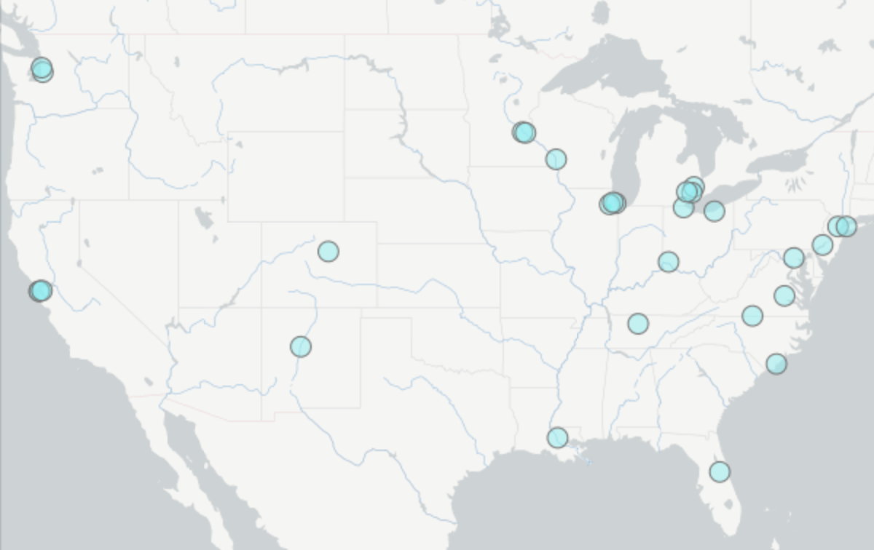
Network Scale
More than 30 health systems represented in the Network; representing more than
500 hospitals, approximately 1/10th of the national total.
Together, members employ more than 1 million people, purchase over $50 billion annually, and have over $150 billion in investment assets.
Notes:
Map reflects system headquarters of the current members (as of July, 2017). For a full list of health systems in the network, see: www.healthcareanchor.network

Slide 13
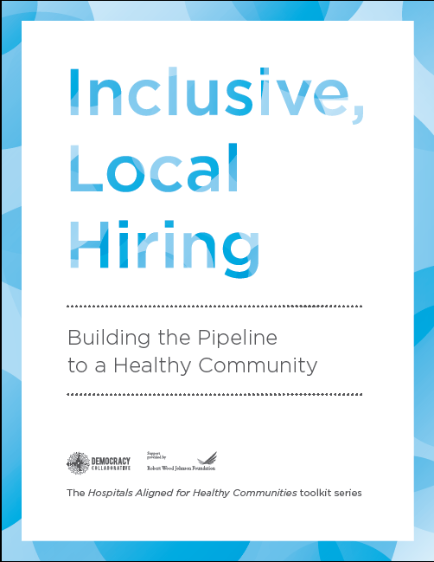
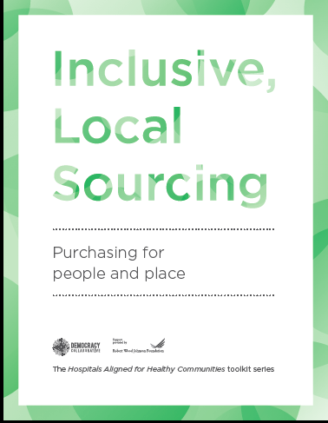
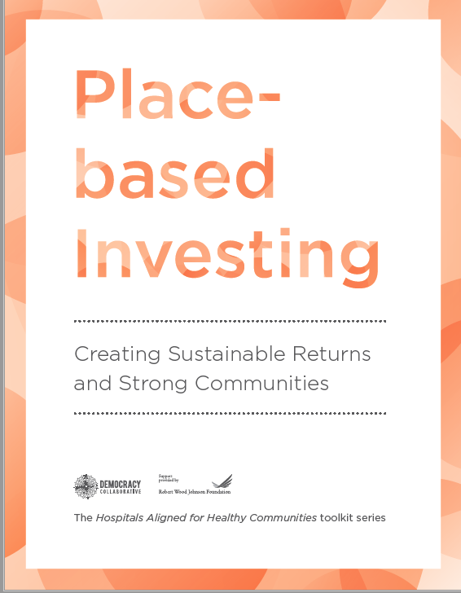
Strategies for Deploying Economic Assets
Notes:
With support from the Robert Wood Johnson Foundation, The Democracy Collaborative published toolkits that provide resources on how to begin to leverage these economic assets for community health and well-being. Available for free at hospitaltoolkits.org, the toolkits provide in-depth case studies, worksheets for getting started, animated explainer videos, infographics, and other resources to equip health systems to move these strategies forward. The toolkits aim to help health systems integrate community health principles into three distinct business functions: (1) inclusive, local hiring and workforce development, (2) local and diverse sourcing; and (3) leveraging their long-term investment portfolios for community investment.
For more information, see: http://hospitaltoolkits.org/

Slide 15
Chicago Anchors for a Strong Economy
Notes:
The partners are…

Slide 16
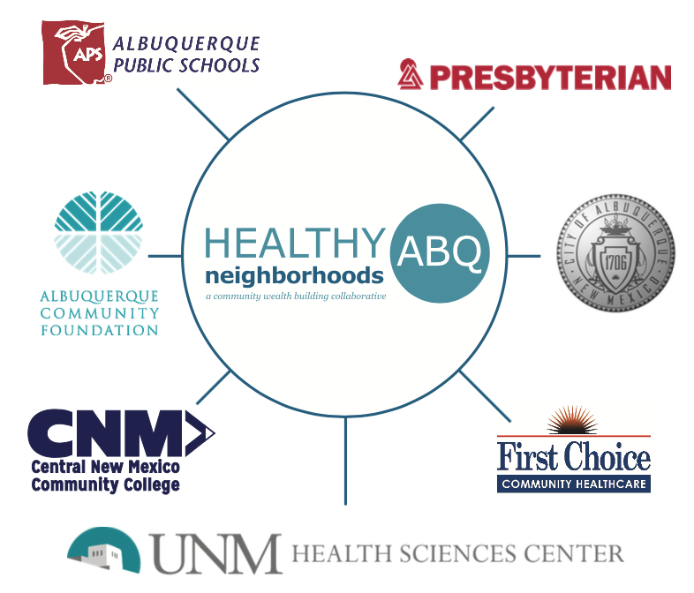
Notes:
The partners are…

Slide 17


Slide 18
