Slide 1
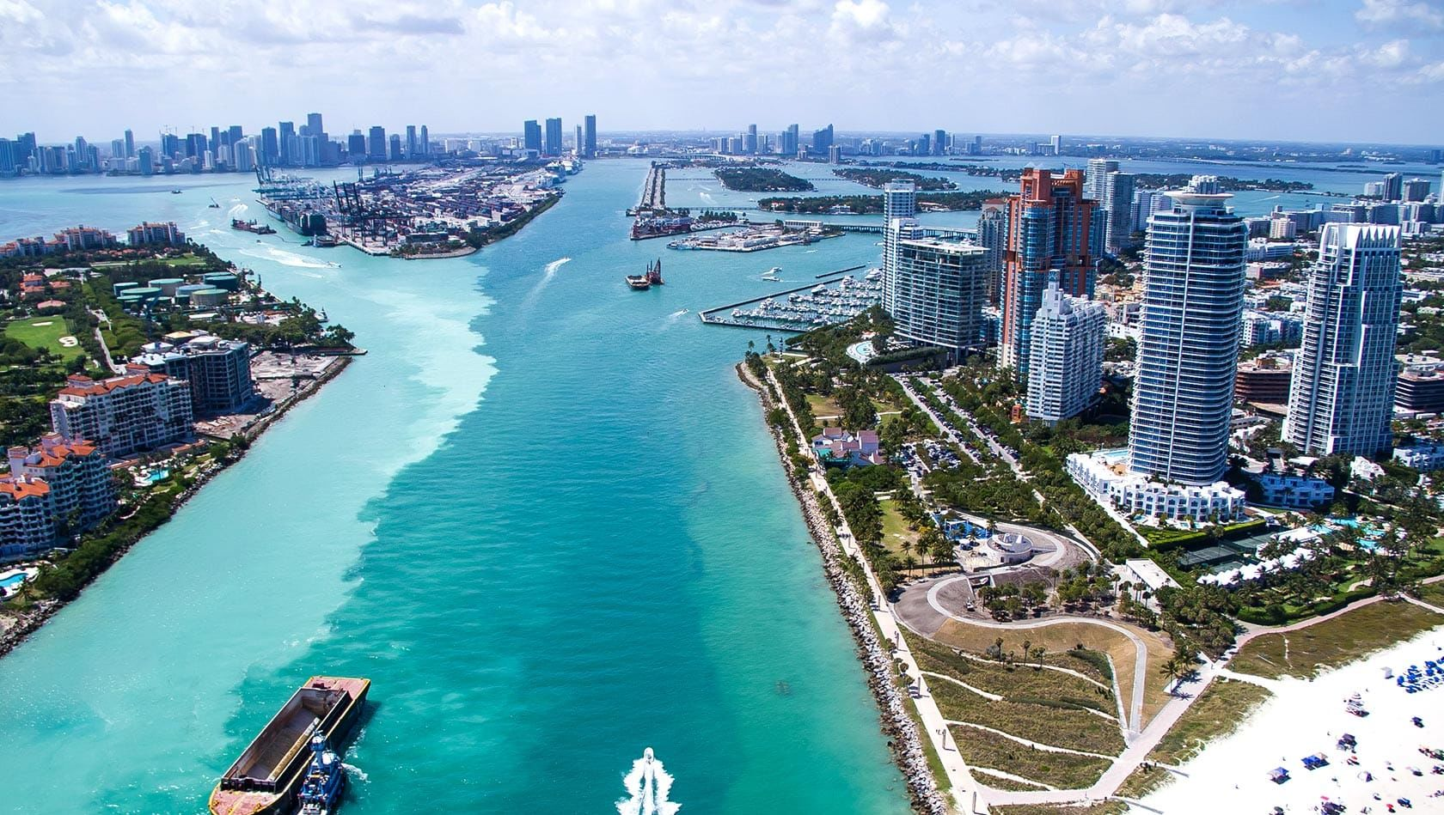
Community Wealth Building in South Florida

Slide 2
Introductions
The Democracy Collaborative Team

Slide 3
&

Slide 4
Introductions
Name
Title
Organization
Something that you’re proud of in the work that your organization does in the community

Slide 5
Plan for the day
Introductions
Quick reminder of why were here
Guest presentations from Lucy and Sheldon
Workshop our common challenges

Slide 6
Miami Anchor Project Timeline
Kick-off
Interviews
Workshop
Design
Report
December Convening

Slide 7
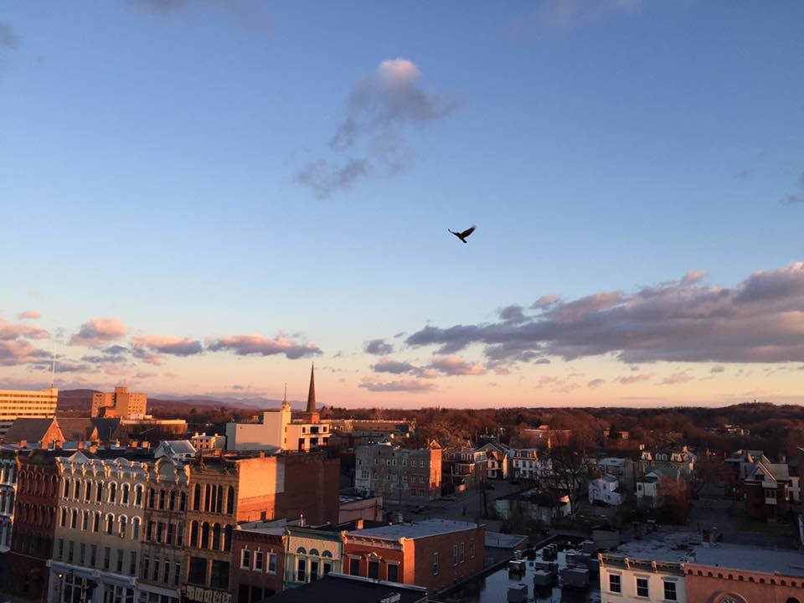

Slide 8
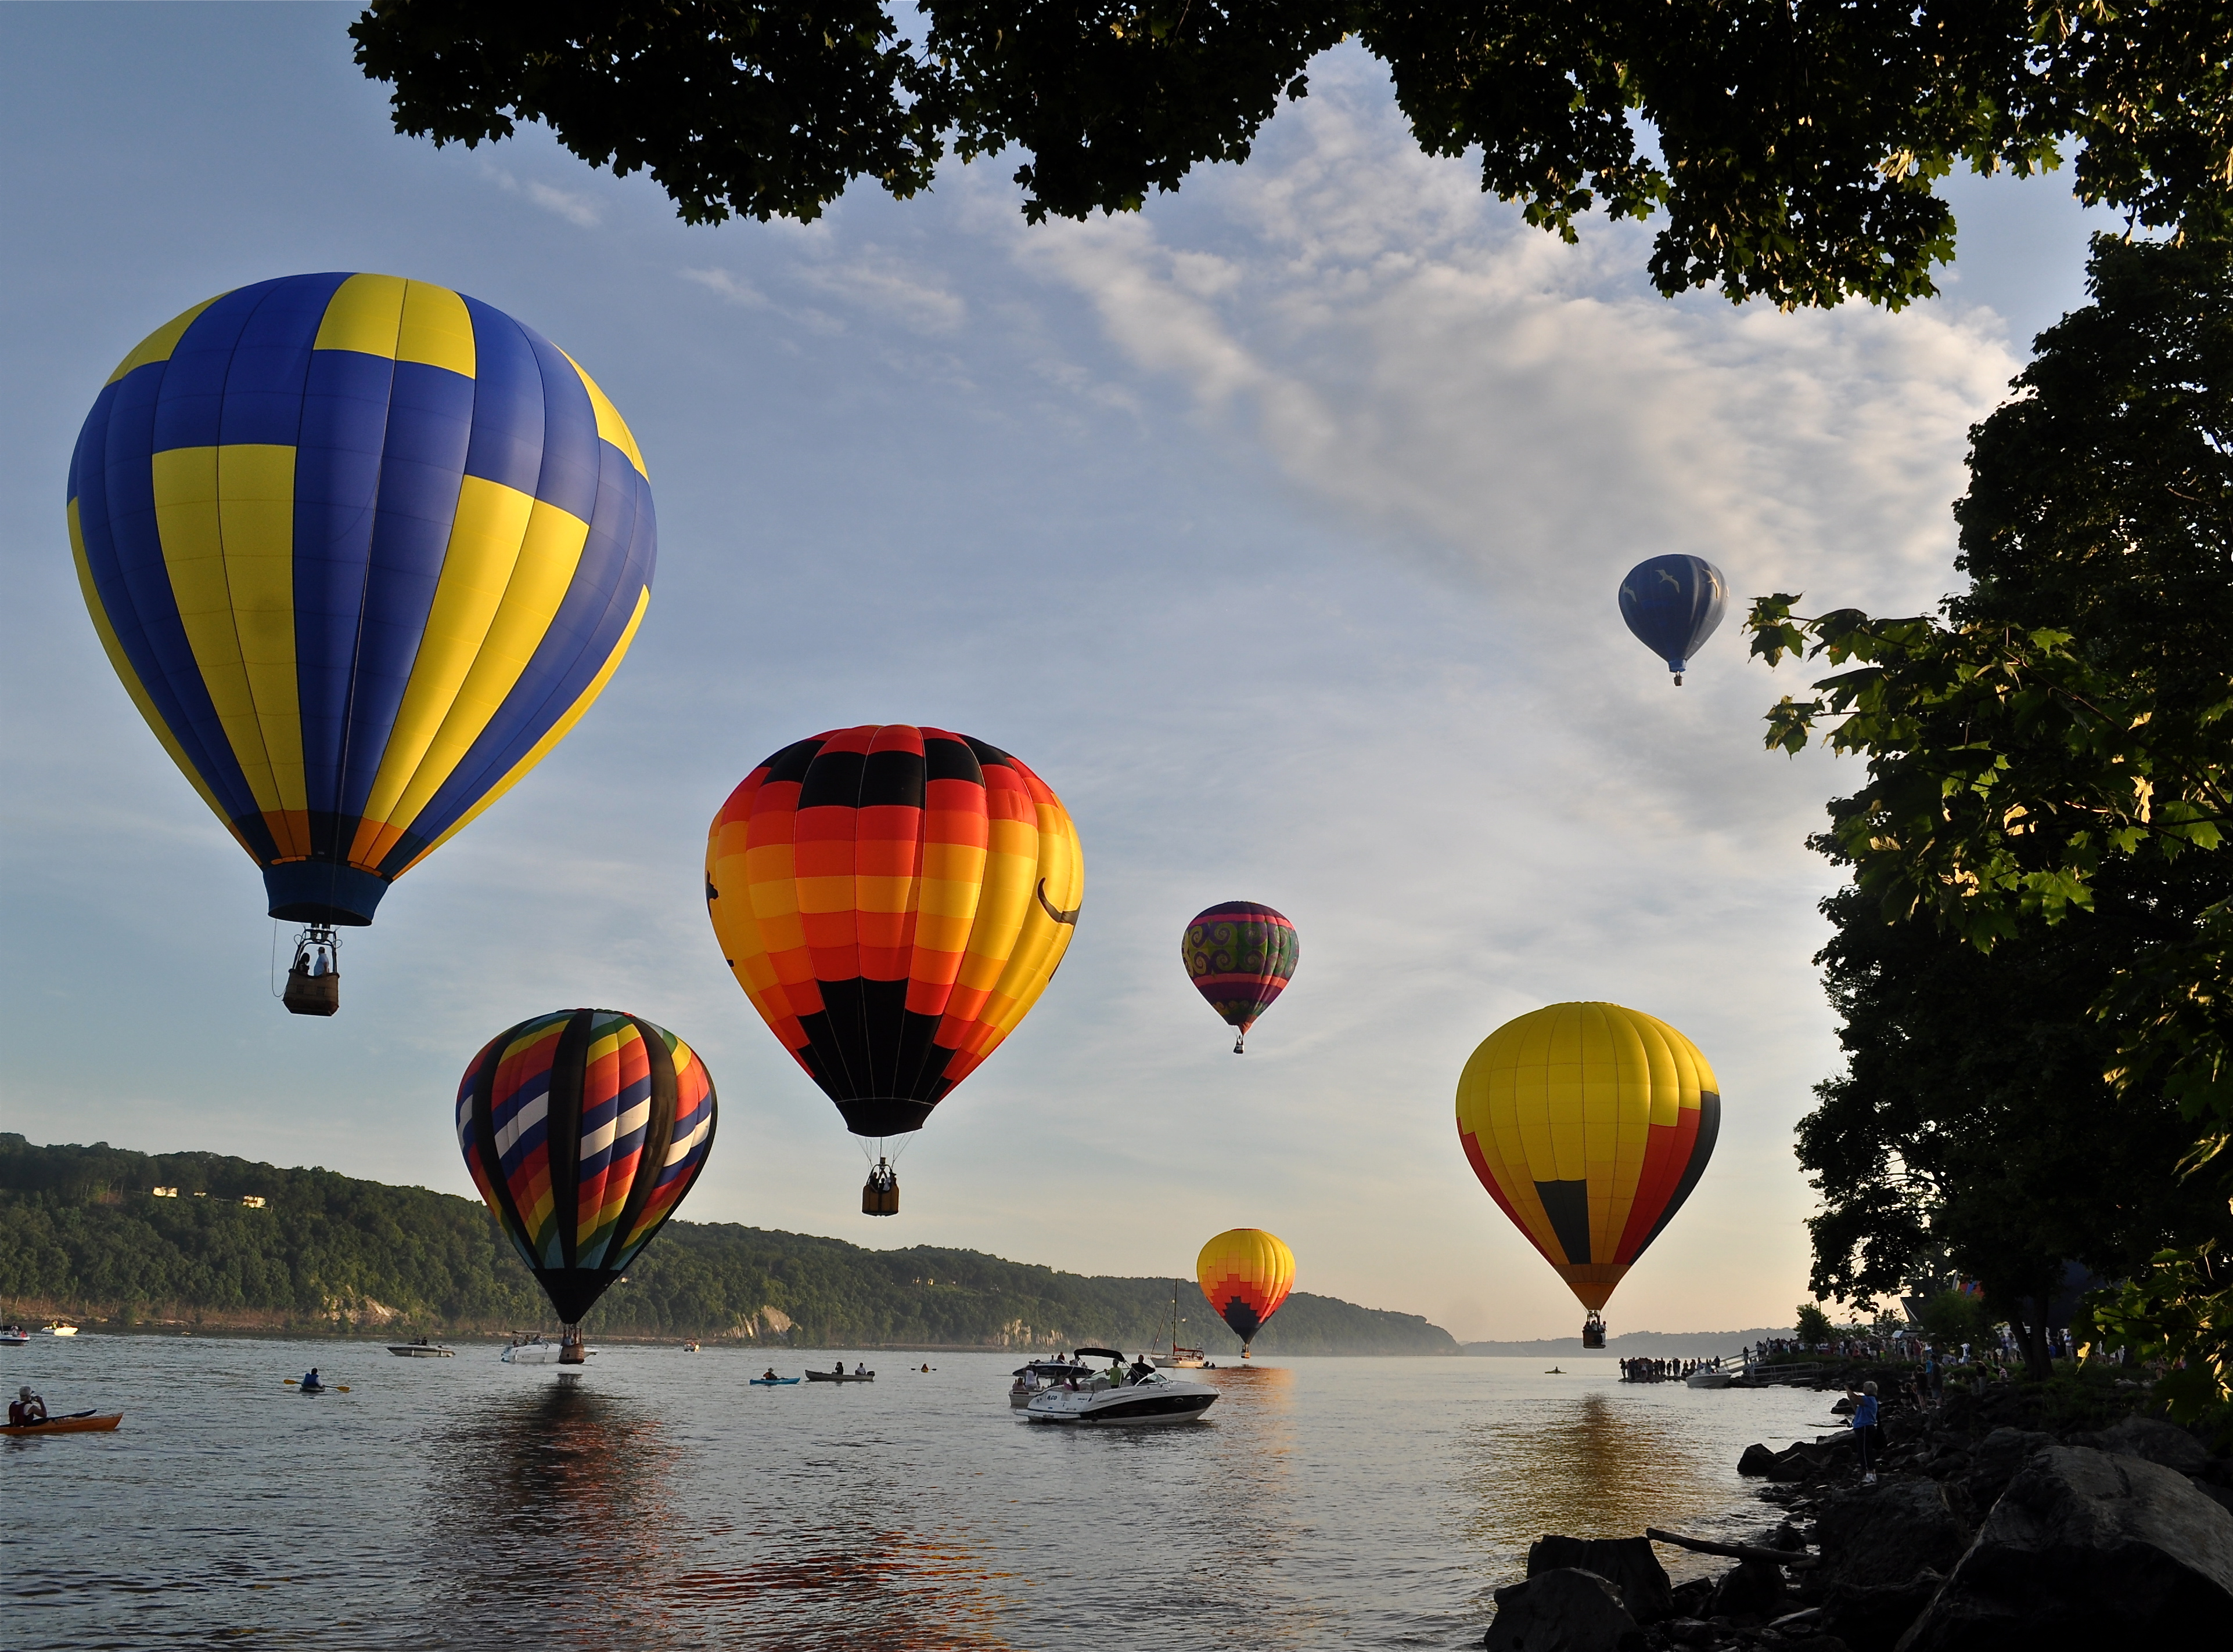

Slide 9
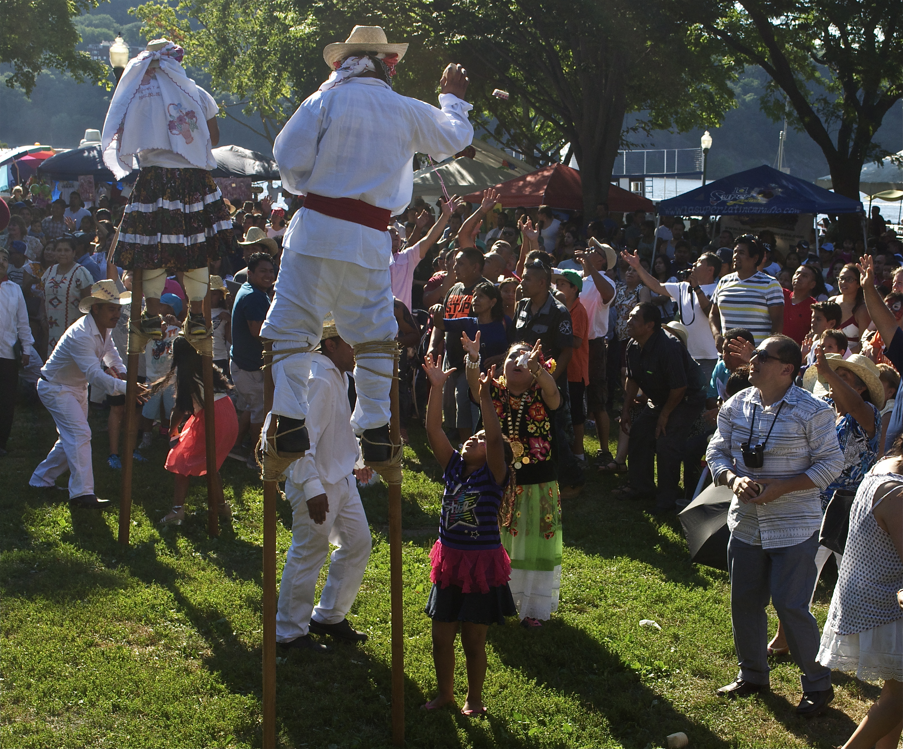

Slide 10
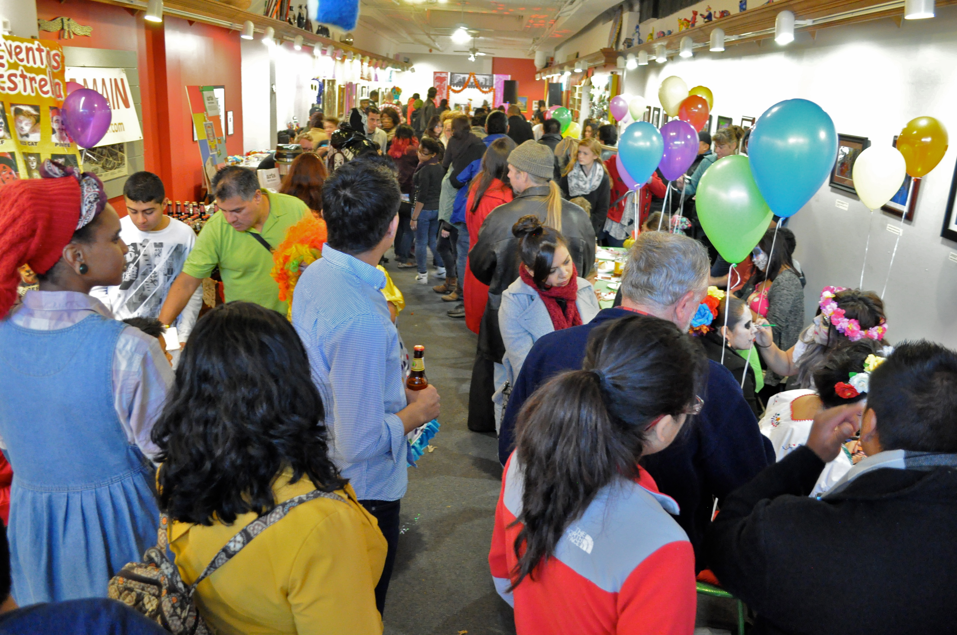

Slide 11
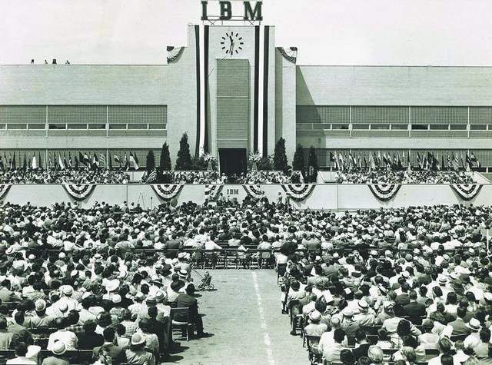

Slide 12
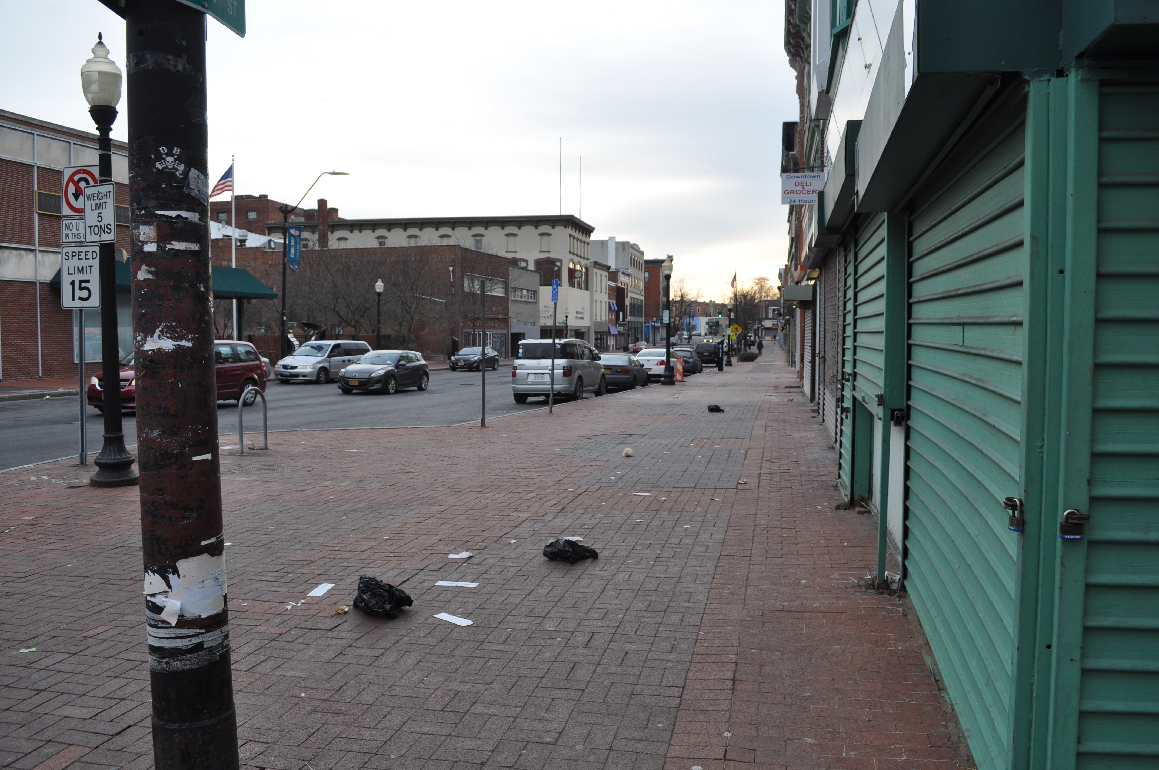
30% poverty rate
14.5% unemployment rate
19.9% minority residents

Slide 13
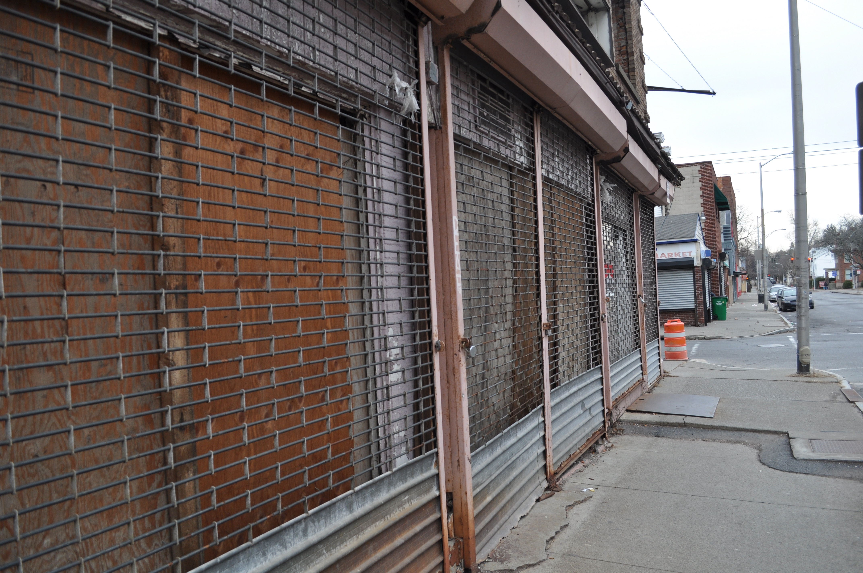
30% of commercial and 36% of residential spaces on Main Street are vacant

Slide 14
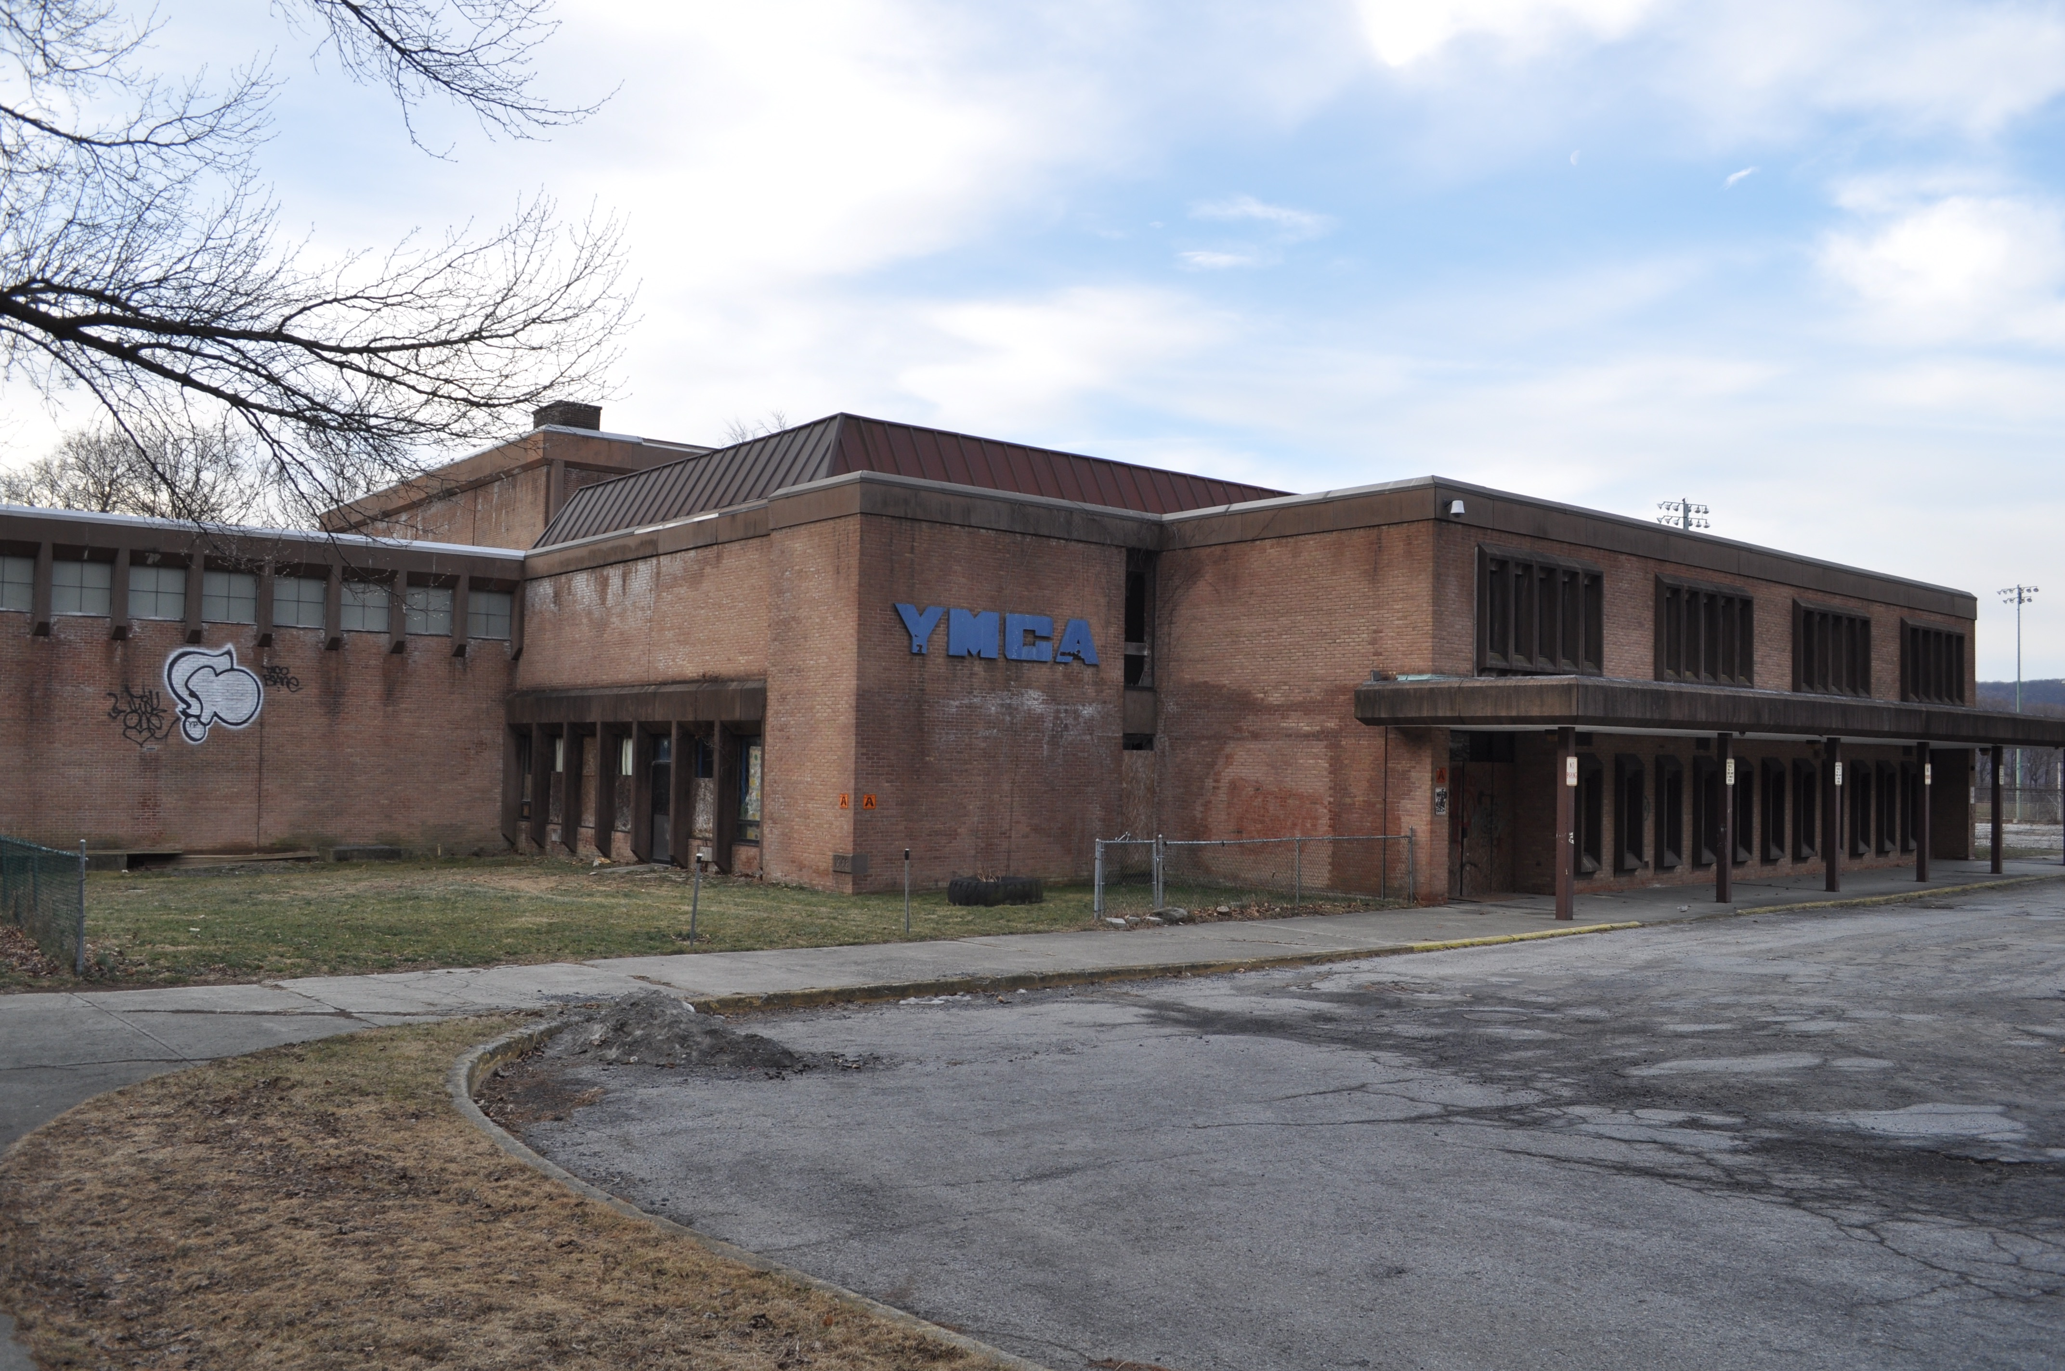
1 million square feet of vacant
commercial space

Slide 15
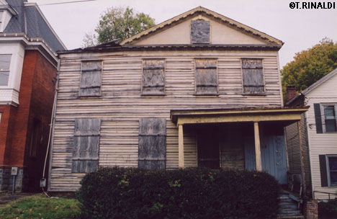
500 vacant homes

Slide 17
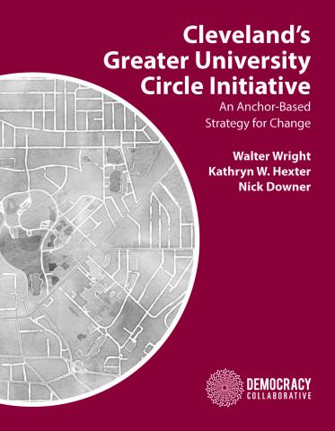
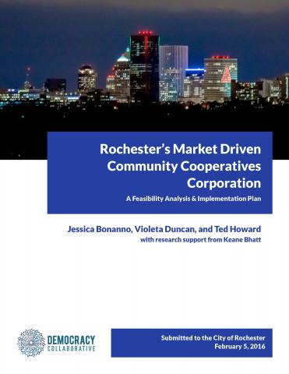

Slide 18
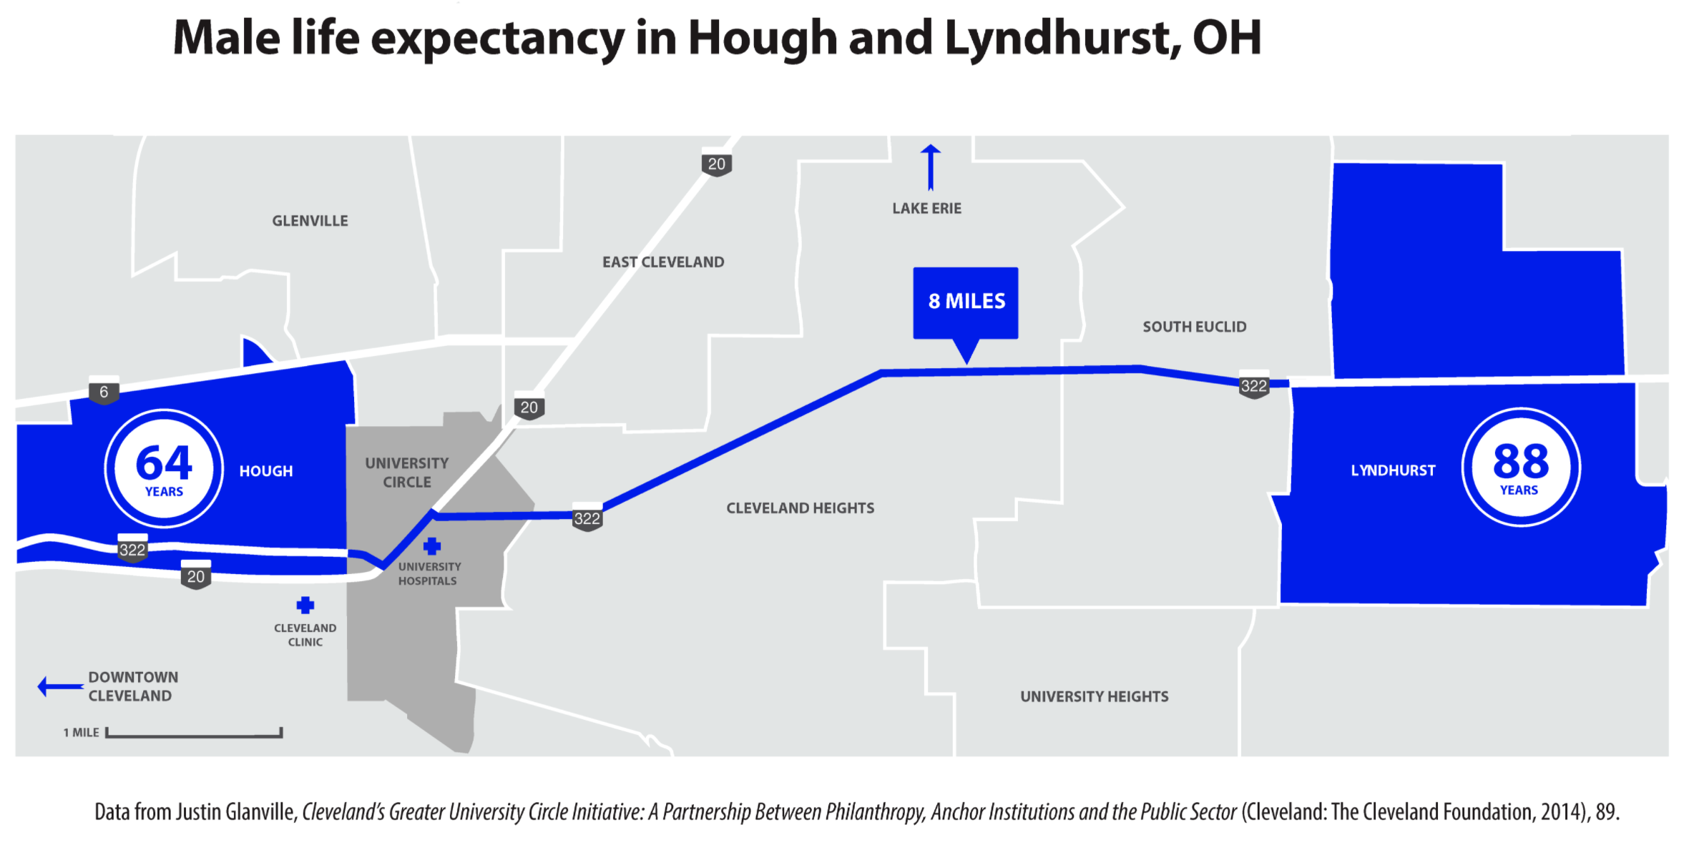
Place Matters:

Slide 19
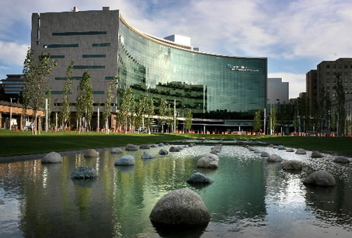
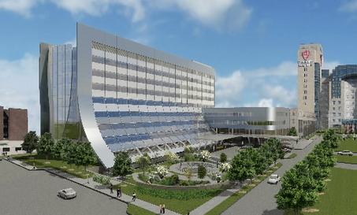
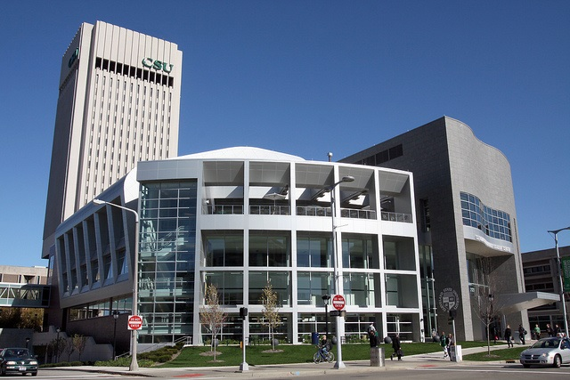
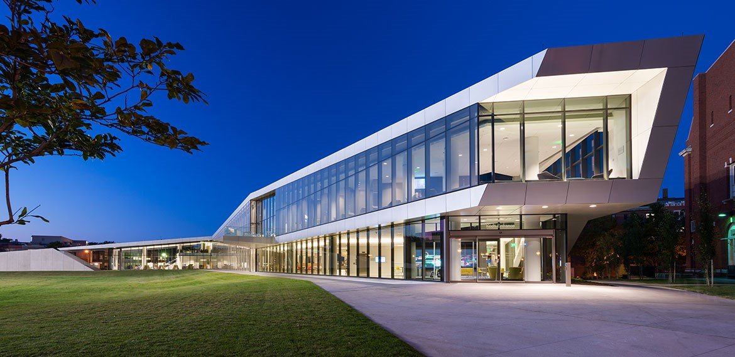
CLEVELAND ANCHOR INSTITUTION PROCUREMENT
$3 Billion+ Annually
Cleveland Clinic
University Hospitals
Cleveland State University
4. Case Western Reserve University
Notes:
19

Slide 20
Community Wealth Building
A systems approach to economic development built on locally rooted and broadly held ownership…
… So that reliable new outcomes
– equity, inclusion, economic stability, resilience –
are produced as a natural consequence of the functioning of the economy…

Slide 21
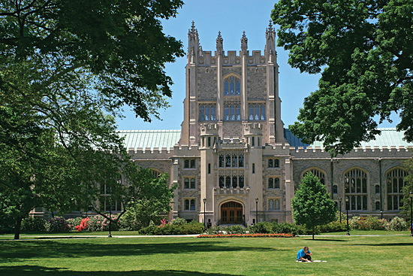
Notes:
Hospitals and

Slide 22
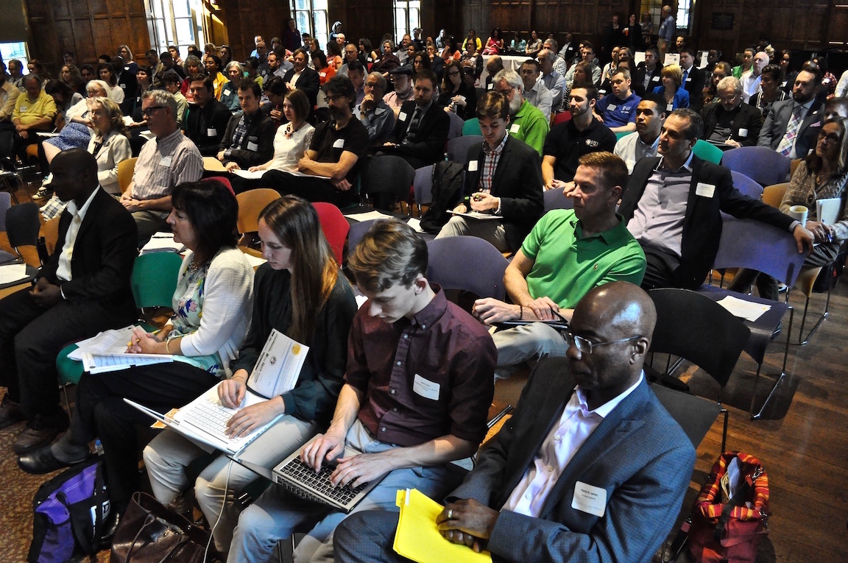
The Poughkeepsie Community Wealth Building

Slide 23
A word from…

Slide 24
What challenges sound familiar?
What stands out to you?
What do you most relate to?

Slide 25
CURRENT STATES

Slide 27
FUTURE States
If the challenge is the state of things today, what do we want the state of things to be in the future?

Slide 28
FUTURE States
Focus on needs first
Are not a specific solution
Provide a space for problem solving
Are a basis to evaluate possible solutions and avoid ones that aren’t working

Slide 29
FUTURE States EXAMPLE
Current State
Future State
No local farms produce lettuce

Slide 30
FUTURE States
Write your own
Focus on needs first
Are not a specific solution
Provide a space for problem solving
Are a basis to evaluate possible solutions and avoid ones that aren’t working

Slide 31
Brainstorming Solutions
Come up with as many solutions as possible to the challenge
One solution per sticky note
Notes:
Activity/content:
Solutioning
Facilitation notes:
Quick introduction to the activity (3 minutes)
Come up with as many solutions as possible to the challenge. Work in silence, putting each possible solution on a sticky note and posting on the wall next to the flip chart with the current/future state (5 minutes)
After 5 minutes, flip groups. Spend 2 minutes reading what the other groups have written and spend 3 minutes adding additional ideas/thoughts (5 minutes)
Outcome:
Quickly iterate a large quantity of possible solutions.
Open up participants minds to coming up with solutions to the identified challenges.
Generate positive energy and creative engagement

Slide 32
Brainstorming Solutions
What we’re looking for:
What we’re not looking for:
A concrete action that can be taken towards a specific outcome.
A statement about an issue, or a declaration or assertion about a challenge or opportunity.
Example: Partner with local farmers to scale lettuce production
Example: We need more lettuce to be grown locally
Notes:
Activity/content:
Solutioning
Facilitation notes:
Quick introduction to the activity (3 minutes)
Come up with as many solutions as possible to the challenge. Work in silence, putting each possible solution on a sticky note and posting on the wall next to the flip chart with the current/future state (5 minutes)
After 5 minutes, flip groups. Spend 2 minutes reading what the other groups have written and spend 3 minutes adding additional ideas/thoughts (5 minutes)
Outcome:
Quickly iterate a large quantity of possible solutions.
Open up participants minds to coming up with solutions to the identified challenges.
Generate positive energy and creative engagement

Slide 33
Brainstorming Solutions
Rapid iteration.
No talking.
Only writing.
Notes:
Activity/content:
Solutioning
Facilitation notes:
Quick introduction to the activity (3 minutes)
Come up with as many solutions as possible to the challenge. Work in silence, putting each possible solution on a sticky note and posting on the wall next to the flip chart with the current/future state (5 minutes)
After 5 minutes, flip groups. Spend 2 minutes reading what the other groups have written and spend 3 minutes adding additional ideas/thoughts (5 minutes)
Outcome:
Quickly iterate a large quantity of possible solutions.
Open up participants minds to coming up with solutions to the identified challenges.
Generate positive energy and creative engagement

Slide 34
Prioritize Solutions
Group solutions into categories
Notes:
Activity/content:
Prioritizing
Facilitation notes:
Return to your original current/future state. Read and discuss the solutions. Group them into categories. Try to come to agreement over which solution is the top one. (7 minutes)
Report out as a group:
What came up when you were coming up with solutions? What surprised you? What trends did you see? What is your top solution and why?
Outcome:
Process the activity and learn about the areas in which the group is most interested in working.

Slide 35
What came up when you were coming up with solutions?
What surprised you?
What trends did you see?
What is your top solution and why?

Slide 36
Miami Anchor Project Timeline
Kick-off
Interviews
Workshop
Design
Report
December Convening

Slide 37
Thank you!

