Slide 1
Addressing America’s Health Challenges: A Vital Role for Community Development
David R. Williams, PhD, MPH
Florence & Laura Norman Professor of Public Health
Professor of African & African American Studies and of Sociology
Harvard University

Slide 2
The Big Picture
U.S. ranks near the bottom of industrialized countries on health, and we are losing ground:
1960 = 11th on infant mortality;
2004 = 29th. US ranked behind Cuba, Korea, Czech Republic, Greece, N. Ireland and Hungary in taking care of our infants.
And it is not just the minorities doing badly! In 2004, white America would be = 26th; Blacks = 35th (just behind Russia).

Slide 3
A Larger Context for Disparities
There are large racial, socioeconomic, and geographic disparities in health but they should be understood within the context of the larger national disparity
All Americans are far less healthy than we could, and should be

Slide 4
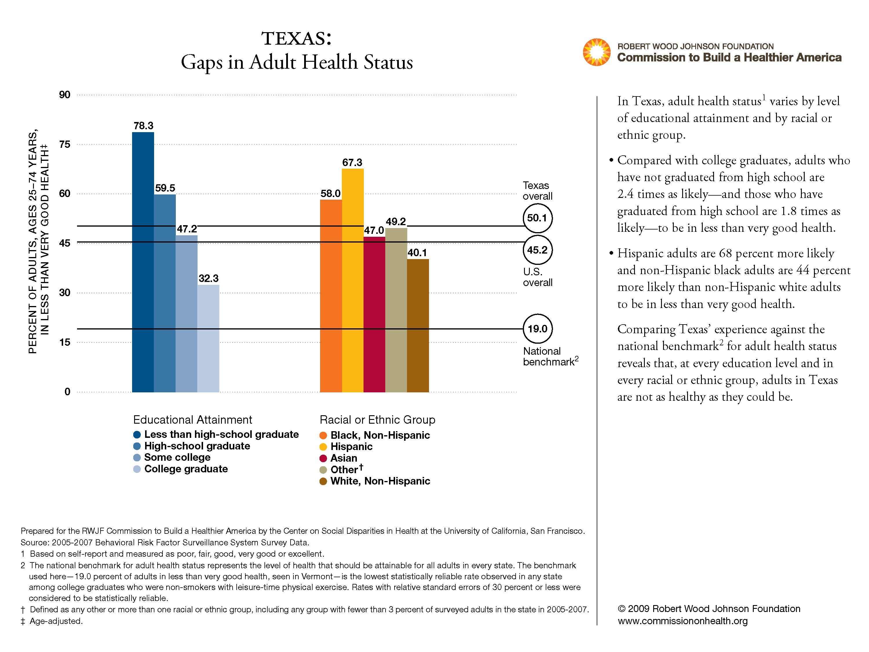

Slide 5
SAT Scores by Income
Family Income | Median Score
More than $100,000 | 1129
$80,000 to $100,000 | 1085
$70,000 to $80,000 | 1064
$60,000 to $70,000 | 1049
$50,000 to $60,000 | 1034
$40,000 to $50,000 | 1016
$30,000 to $40,000 | 992
$20,000 to $30,000 | 964
$10,000 to $20,000 | 920
Less than $10,000 | 873
Source: (ETS) Mantsios; N=898,596

Slide 6
SES: A Key Determinant of Heath
Socioeconomic Status (SES) usually measured by income, education, or occupation influences health in virtually every society
SES is one of the most powerful predictors of health, more powerful than genetics, exposure to carcinogens, and even smoking
The gap in all-cause mortality between high and low SES persons is larger than the gap between smokers and non-smokers.

Slide 7
Relative Risk of Premature Death by Family Income (U.S.)
Relative Risk
Family Income in 1980 (adjusted to 1999 dollars)
9-year mortality data from the National Longitudinal Mortality Survey

Slide 8
Lung Cancer Death Rates, Men, 2001
Deaths per 100,000
Education in Years
Albano et al. 2007, JNCI

Slide 9
Low SES: Multiple Disadvantages
Poor education in childhood and adolescence
Insecure employment or unemployment
Stuck in hazardous or dead-end jobs
Living in poor housing
Living in neighborhoods with fewer resources
Trying to raise a family in difficult circumstances
Living on an inadequate pension
Eat poorly, forgo exercise, skip medications
WHO: The Solid Facts

Slide 10
Percent Poor by Race/Ethnicity
Poverty Rate
U.S. Census 2006
Notes:
--These are the percentages listed in Table 8 of U.S. Census 2006.
--“Some Other Race alone” not included
(“Number and Percentage of People in Poverty in the Past 12 Months by Race and Hispanic Origin: 2006)

Slide 11
Racial Disparities in Health
African Americans have higher death rates than Whites for 12 of the 15 leading causes of death.
Blacks and American Indians have higher age-specific death rates than Whites from birth through the retirement years.
Hispanics have higher death rates than whites for diabetes, hypertension, liver cirrhosis & homicide
Minorities get sick younger, have more severe illness and die sooner than Whites

Slide 12
Life Expectancy Lags, 1950-2006
77.6
78.2
76.1
74.4
71.7
73.2
70.6
71.4
69.1
68.2
69.1
63.6
64.1
60.8
Murphy, NVSS 2000; Braveman et al. in Press, NLMS 1988-1998

Slide 13
Life Expectancy At Age 25
Group | White | Black | Difference
All | 53.4 | 48.4 | 5.0
Murphy, NVSS 2000; Braveman et al. AJPH, 2010; NLMS 1988-1998

Slide 14
Life Expectancy At Age 25
Group | White | Black | Difference
All Education | 53.4 | 48.4 | 5.0
a. 0-12 Years | 50.1
b. 12 Years | 54.1
c. Some College | 55.2
d. College Grad | 56.5
Difference | 6.4
Murphy, NVSS 2000; Braveman et al. AJPH, 2010; NLMS 1988-1998

Slide 15
Life Expectancy At Age 25
Group | White | Black | Difference
All Education | 53.4 | 48.4 | 5.0
a. 0-12 Years | 50.1 | 47.0
b. 12 Years | 54.1 | 49.9
c. Some College | 55.2 | 50.9
d. College Grad | 56.5 | 52.3
Difference | 6.4 | 5.3
Murphy, NVSS 2000; Braveman et al. AJPH, 2010; NLMS 1988-1998

Slide 16
Life Expectancy At Age 25
Group | White | Black | Difference
All Education | 53.4 | 48.4 | 5.0
a. 0-12 Years | 50.1 | 47.0 | 3.1
b. 12 Years | 54.1 | 49.9 | 4.2
c. Some College | 55.2 | 50.9 | 4.3
d. College Grad | 56.5 | 52.3 | 4.2
Difference | 6.4 | 5.3
Murphy, NVSS 2000; Braveman et al. AJPH, 2010; NLMS 1988-1998

Slide 17
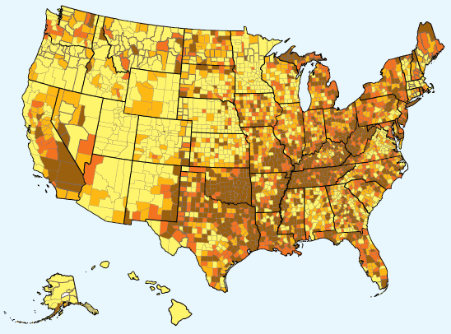

Mapping Disease: Geographic differences in health often mirror geographic differences in income, education, and racial or ethnic composition
Disease varies geographically.
For example, higher rates of death due to heart disease are often seen in areas where fewer adults have college educations.

Slide 18
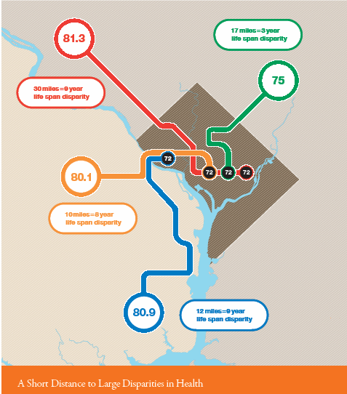
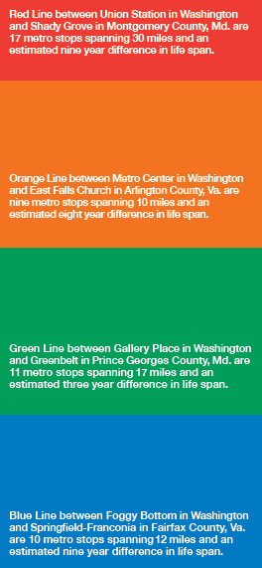

Slide 19
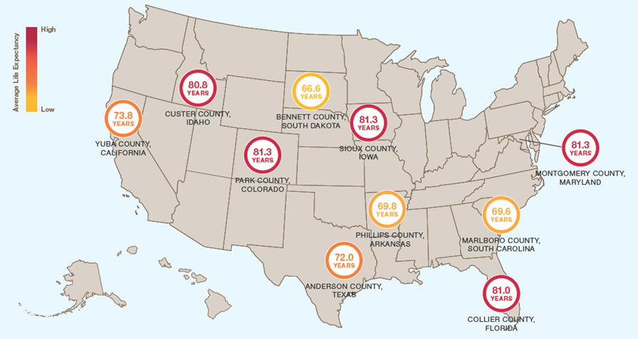
Across America, Differences in How Long and
How Well We Live

Slide 20
Options for Community Development
Improved access to health care is essential, but it will not make us a healthy nation
An individual’s chances of getting sick are largely unrelated to the receipt of medical care
Where we live, learn, work, play and worship determine our opportunities and chances for being healthy
Social Policies can make it easier or harder to make healthy choices

Slide 21
RWJF Commission to Build a Healthier
America: Challenges and Opportunities
David R. Williams, PhD, MPH
Staff Director

Slide 22
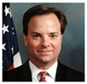

Commission Leadership
Mark McClellan
Physician and economist who helped develop and then effectively implemented Medicare prescription drug benefit. Former CMS Administrator (2004) and FDA Commissioner (2002). Director of the Engelberg Center for Health Care Reform, Senior Fellow in Economic Studies and Leonard D. Schaeffer Director's Chair in Health Policy Studies at the Brookings Institution.
Alice M. Rivlin
Former U.S. Cabinet official, and an expert on the budget. First woman to hold the position of Director of the Office of Management and Budget and was founding director of the Congressional Budget office. Currently, Director of Greater Washington Research Program at Brookings Institution.
© 2008 Robert Wood Johnson Foundation. All rights reserved.
22
Notes:
9/28/2011
22

Slide 23






Commissioners
Katherine Baicker
Professor of Health Economics, Department of Health Policy and Management, Harvard University
Angela Glover Blackwell
Founder and Chief Executive Officer, PolicyLink
Sheila P. Burke
Faculty Research Fellow and Adjunct Lecturer in Public Policy, Kennedy School of Government, Harvard University
Linda M. Dillman
Executive Vice President of Benefits and Risk Management, Wal-Mart Stores, Inc.
Sen. Bill Frist
Schultz Visiting Professor of International Economic Policy, Princeton University
Allan Golston
U.S. Program President, The Bill & Melinda Gates Foundation
© 2008 Robert Wood Johnson Foundation. All rights reserved.
23
Notes:
9/28/2011
23

Slide 24






Commissioners
Kati Haycock
President, The Education Trust
Hugh Panero
Co-Founder and Former President and Chief Executive Officer, XM Satellite Radio
Dennis Rivera
Chair, SEIU Healthcare
Carole Simpson
Leader-in-Residence, Emerson College School of Communication and Former Anchor, ABC News
Jim Towey
President, Saint Vincent College
Gail L. Warden
Professor, University of Michigan School of Public Health and
President Emeritus, Henry Ford Health System
© 2008 Robert Wood Johnson Foundation. All rights reserved.
24
Notes:
9/28/2011
24

Slide 25
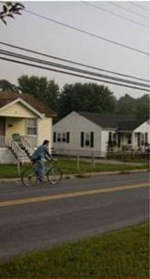
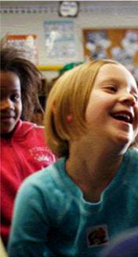
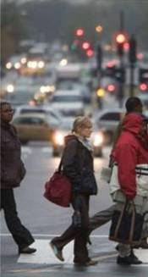
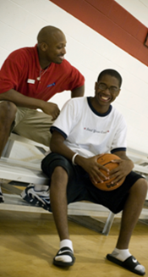
So what makes us sick in the first place?
And why are some Americans so much
healthier than others?
Where we Live, Learn, Work and Play has a greater impact on how long and how well we live than medical care
Notes:
Where we live, learn, work and play has a greater impact on how long and how well we live than medical care. Some Americans live 20 years less than others living just a few miles away because of differences in education, wealth, their racial or ethnic group, and where and how they live.

Slide 26

A twin philosophy: Good health requires personal responsibility and a societal commitment to remove the obstacles preventing too many Americans from making healthy decisions
The Commission’s Recommendations
The recommendations focus on people and the places where we spend the bulk of our time:
Homes and Communities
Schools
Workplaces
Building a healthier America is feasible in years, not decades, if we collaborate
and act on what is making a difference
Notes:
The recommendations are rooted in a twin philosophy: good health requires individuals to make responsible personal choices and requires a societal commitment to remove the obstacles preventing too many Americans from making healthy decisions.
The recommendations focus on people and the places where we spend the bulk of our time: homes and communities, schools and workplaces.

Slide 27
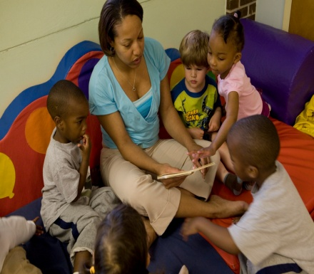
Starting Early
Ensure that all children have high-quality early developmental support (child care, education and other services). This will require committing substantial additional resources to meet the early developmental needs particularly of children in low-income families.
Feed children only healthy foods in schools.
Require all schools (K-12) to include time for all children to be physically active every day.

Slide 28
Early Childhood Assistance
Investments in early childhood programs in the U.S. have been shown to have decisive beneficial effects

Slide 29
High/Scope Perry Preschool
African-American children, living in poverty and at risk of school failure.
Randomly assigned to initially similar program and no-program groups.
4 teachers with bachelors’ degrees held a daily class of 20-25 three- and four-year-olds and made weekly home visits.
Children participated in their own education by planning, doing, and reviewing their own activities.
Notes:
So David Weikart and his colleagues decided to run a preschool program. Some early childhood educators, however, feared this would not help and might even harm the children. So Weikart and colleagues decided to conduct a study of the program’s effects. From 1962 to 1965, they identified 123 young African-American children living in poverty and at risk of school failure. They defined poverty as parents having little schooling (9th grade average) and low occupational status (unemployed or unskilled jobs), along with high household density (1.4 persons per room).
The key to the scientific strength of this study is that children were randomly assigned to program or no-program group – essentially by a flip of the coin. The two resultant groups were almost exactly alike in background characteristics, except that one group got the preschool program and the other did not. The program employed 4 certified teachers serving 20-25 children with daily class and weekly home visits. This was a program of participatory education, in which children could plan, do, and re view their own activities.

Slide 30
Results at Age 40
Those who received the program:
-- had better academic performance (more likely to graduate from high school)
-- did better economically (higher employment, income, savings & home ownership)
-- less criminal behavior (fewer arrests for violent, property & drug crimes)
The program was cost effective: A return to society of $17 for every dollar invested in early education
Schweinhart & Montie, 2005
Notes:
So David Weikart and his colleagues decided to run a preschool program. Some early childhood educators, however, feared this would not help and might even harm the children. So Weikart and colleagues decided to conduct a study of the program’s effects. From 1962 to 1965, they identified 123 young African-American children living in poverty and at risk of school failure. They defined poverty as parents having little schooling (9th grade average) and low occupational status (unemployed or unskilled jobs), along with high household density (1.4 persons per room).
The key to the scientific strength of this study is that children were randomly assigned to program or no-program group – essentially by a flip of the coin. The two resultant groups were almost exactly alike in background characteristics, except that one group got the preschool program and the other did not. The program employed 4 certified teachers serving 20-25 children with daily class and weekly home visits. This was a program of participatory education, in which children could plan, do, and re view their own activities.

Slide 31
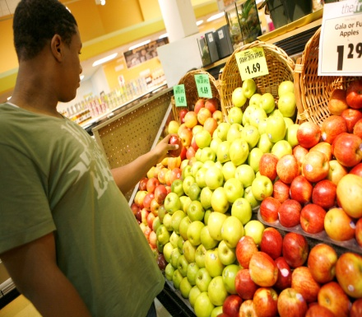
Accessing Healthy Foods
Fund and design WIC and SNAP (Food Stamps) programs to meet the needs of hungry families with nutritious food.
Create public-private partnerships to open and sustain full-service grocery stores in communities without access to healthful foods.

Slide 32
Challenge of Obesity
More than 23 million U.S. children and adolescents are obese or overweight
For the 1st time in history, we are raising children that will live sicker, shorter lives than their parents
Doubling of obesity since 1987 accounts for almost 30% of the increase in health care costs
If current trends continue, more than 44 million Americans will have diabetes in 25 years
And the costs of treating diabetes will triple
School-based interventions can be effective in increasing physical activity and healthy eating and in preventing overweight and obesity
Williams, McClellan, Rivlin, Health Affairs, 2010

Slide 33
‘Food Deserts’ in PA
The Food Trust – Building strong communities through healthy foods
-- Farmer’s markets, Co-ops, school initiatives
Fresh Food Financing Initiative’s Supermarket Campaign in collaboration with the Reinvestment Fund and the Philadelphia Urban Affairs Coalition (a public private partnership)
58 new supermarkets in urban and rural underserved areas

Slide 34
Jeffrey Brown & ShopRite
Operates 10 stores
Half in urban under-served areas
Opened a 65K sq ft supermarket store in inner-city, AA, low income area in summer 2008
Area had been without a supermarket for 30 years
Same price in all stores
Same hours as other stores (7am-11pm)
All stores have community rooms (free)

Slide 35
Innovation
Customized customer service: market research with churches and community organizations
Good community citizen
Community conference room in store
All store managers on local community boards
Support entrepreneurship with minority businesses
40 of 280 employees are ex-offenders (technical and life-skills training)
Quarterly: gifts for guns prog. ($100 cert) (400 guns)

Slide 36
Shattering Myths
No higher level of shrinkage in inner-city supermarkets
High training costs but low turn-over
Same volume of fruit and vegetables sales
Higher poultry and fish sales

Slide 37
Supermarkets:
Engine of economic re-vitalization
Property values increase
Stimulates other retail shopping
Seniors can walk to store
Attracts more capital
Community resource and outreach center (health screening; WIC, CHIP, Food Stamps outreach)

Slide 38
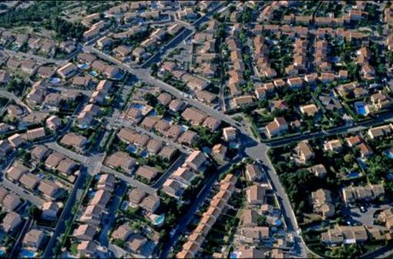
Creating Healthy Communities
Become a smoke-free nation. Eliminating smoking remains one of the most important contributions to longer, healthier lives.
Integrate safety and wellness into every aspect of community life.
Develop a “health impact” rating for housing and infrastructure projects that reflects the projected effects on community health and provides incentives for projects that earn the rating.
Create “healthy community” demonstrations to evaluate the effects of a full complement of health-promoting policies and programs.

Slide 39




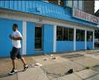
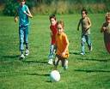
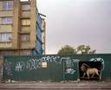
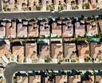
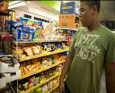

Our Neighborhood Affects Our Health
Unhealthy Community
Healthy Community
vs
Unsafe even in daylight
Safe neighborhoods, safe schools, safe walking routes
Exposure to toxic air, hazardous waste
Clean air and environment
Well-equipped parks and open/spaces/organized community recreation
No parks/areas for physical activity
Limited affordable housing is run-down; linked to crime ridden neighborhoods
High-quality mixed income housing, both owned and rental
Convenience/liquor stores, cigarettes and liquor billboards, no grocery store
Well-stocked grocery stores offering nutritious foods

Slide 40
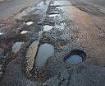

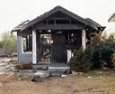
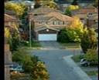
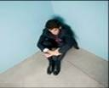

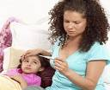
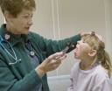
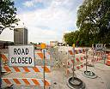

Our Neighborhood Affects Our Health
Unhealthy Community
Healthy Community
vs
Clean streets that are easy to navigate
Streets and sidewalks in disrepair
Burned-out homes, littered streets
Well-kept homes and tree-lined streets
No culturally sensitive community centers, social services or opportunities to engage with neighbors in community life
Organized multicultural community programs, social services, neighborhood councils or other opportunities for participation in community life
Primary care through physicians’ offices or health center; school-based health programs
No local health care services
Lack of public transportation, walking or biking paths
Accessible, safe public transportation, walking and bike paths

Slide 41
Need for A Smoke-Free Nation
Lung cancer is the number one cause of cancer deaths for men and women in the US
Lung cancer kills more Americans annually than breast, prostate, colon and pancreatic cancer combined!
Tobacco causes 1 in 5 deaths in the US
Despite declines in cigarette use, smoking is still the single most preventable cause of death
Smoking causes more deaths than overweight and obesity, high cholesterol, alcohol, and the low intake of fruits and vegetables combined
Danaei et al. PLOS Med 2009; Gruer et al BMJ 2009;

Slide 42
Creating a Culture of Health
Living healthier requires the creation of a culture of health
We need to better incorporate health into our homes, schools, neighborhoods, workplaces
Safety and wellness needs to be integrated into every aspect of community life
Health, therefore, needs to be factored into all policy making
We need to work across traditional policy silos to engage in cross-sector partnerships and solutions
Public and private resources need to be combined

Slide 43
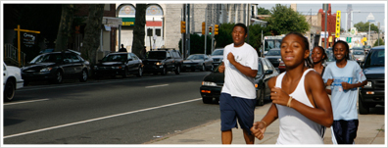
Measuring Progress,
Building In Accountability
Decision makers at national, state, and local levels need reliable data on health status, disparities, and the effects of social determinants of health.
Better data must be developed for use at the local level, in particular.
Fund research to understand the health effects of social factors and promote application of findings by decision makers.
Notes:
Finally, we need better and more localized, disaggregated information about the impact of life circumstances and social and physical environments on our health.

Slide 44
Large Economic Impacts
America’s shortfalls in health are very costly to our society

Slide 45
Costs: Racial Gaps, 2003-06
Medical Care Costs = $229.4 Billion
Lower worker productivity & premature death costs = $1,008 Trillion
Total Costs = $1.24 Trillion
$309.3 Billion annual loss to the economy
Social Justice can be cost effective
Doing nothing has a cost that we should not continue to bear
LaVeist et al. 2009, Joint Center for Political & Economic Studies

Slide 46
Economic Gains from Reducing Education Differences in Health are Large
If all adult Americans experienced the lower death rates and better health status of college graduates, they would live longer and healthier lives.
These improvements would translate into potential gains of $1.007 trillion annually.

Slide 47
Conclusions: Improving America’s Health
Health care system reform is critical, but insufficient
Social factors like education, housing, transportation the environment can have decisive impacts
There are promising approaches from around the country that are making a difference now
Community Development can help to bring resources together in a concerted focus to modify where and how we live, learn, work and play
We need to attend to those who are farthest behind

Slide 48
A Call to Action
“The only thing necessary for the triumph [of evil] is for good men to do nothing.”
Edmund Burke, Irish Philosopher

