Slide 1
Active Living By Design: Engaging Community to Improve Health
September 28, 2011
Risa Wilkerson
risa_wilkerson@unc.edu
919-843-3519

Slide 2
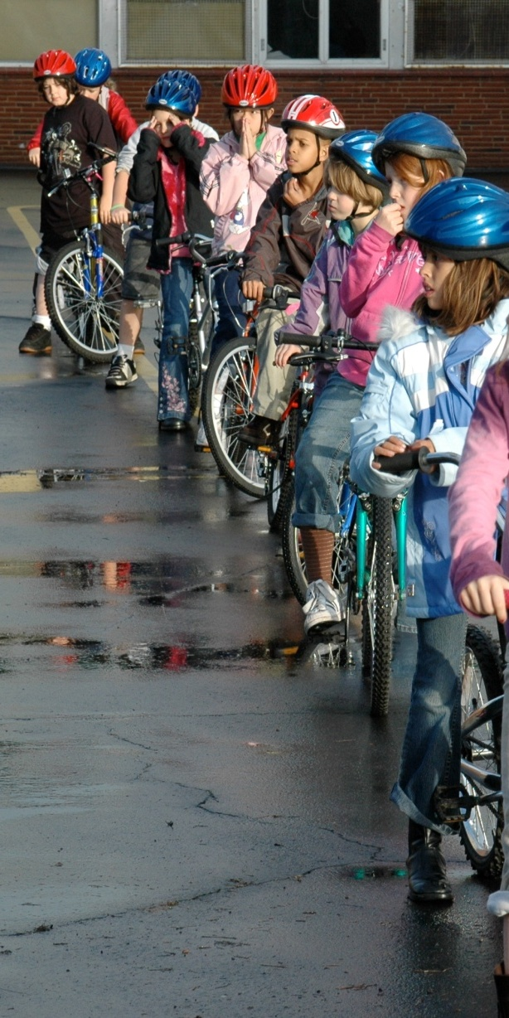
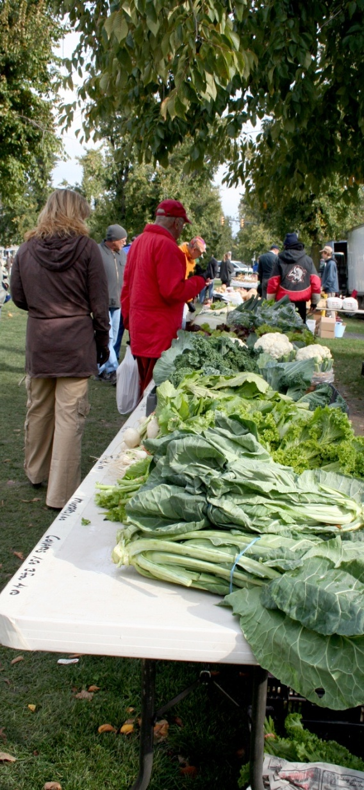
ALBD’s mission:
Active Living By Design (ALBD) creates community-led change by working with local and national partners to build a culture of active living and healthy eating.
“Our vision is healthy communities, where routine physical activity and healthy eating are accessible, easy and affordable to everyone.”
Notes:
Slide Summary: ALBD’s mission and vision statements.
Take Home Message: Overarching goal is promote healthy communities, where routine physical activity and healthy eating are accessible, easy and affordable to everyone.

Slide 3
What do we do?
Serve as the National Program Office for programs funded by the Robert Wood Johnson Foundation
Manage multiple grant programs for various funders
Provide technical assistance to our grantees
Conduct training sessions, workshops and seminars for grantees and funders
Provide intensive coaching and share lessons learned from the field -- “best practices”
Notes:
Slide Summary: Description of how ALBD accomplishes its mission.
Take Home Message: ALBD serves as the National Program Office for two major RWJF initiatives. Multiple mechanisms are used to encourage physical activity and to build the field.

Slide 4
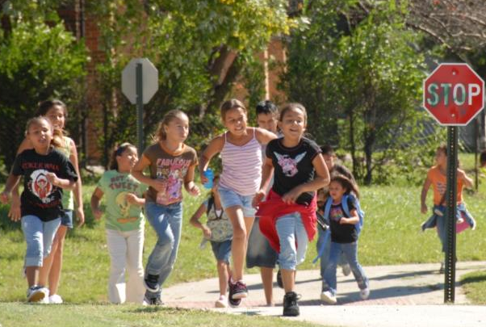
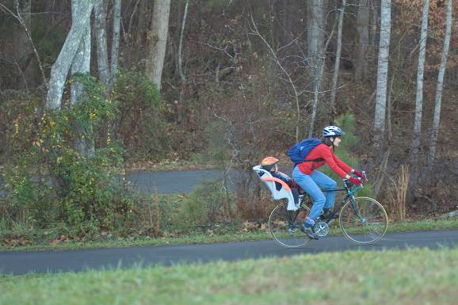
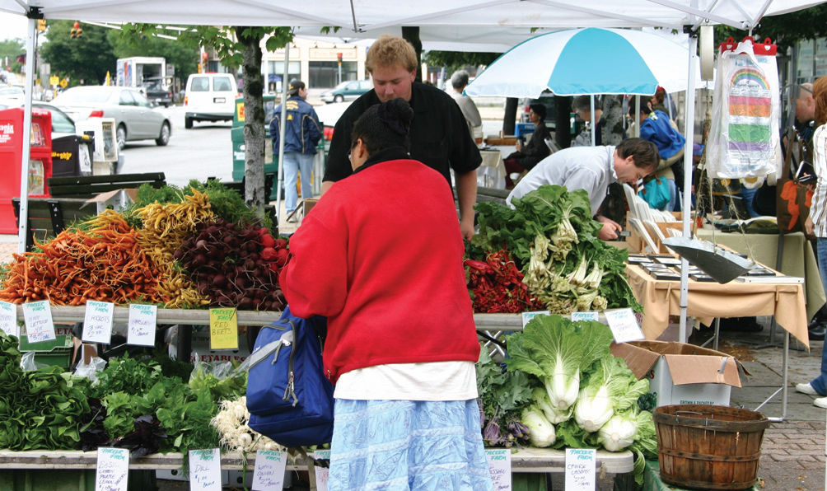
What is “Active Living and Healthy Eating by Design?”
Active Living and Healthy Eating by Design is a way of life that integrates physical activity and healthy eating into daily routines.
Notes:
Slide Summary: Description of what we mean by “Active Living”
Take Home Message: PA is incorporated into daily routine rather than an “add on” to the day.

Slide 5
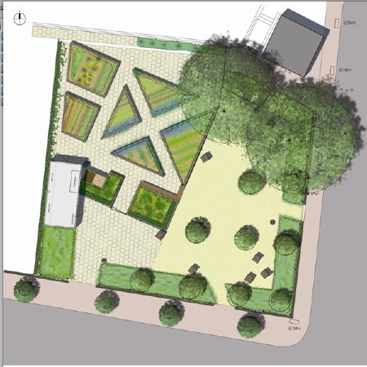
What is “by design?”
Design is the aesthetic, physical, and functional qualities of the built environment. This includes buildings and streetscapes, and relates to both land use patterns and the transportation system.
Making changes to policy and environments can ensure that individuals can change and sustain healthy behaviors.
Notes:
Slide Summary: Description of what we mean by “By Design”
Take Home Message: PA and HE are influenced by policy and the built environment. Traditional means of behavior change such as programs and promotions can be limited to the campaign or program length whereas built environment changes remove barriers to PA and will last generations.

Slide 6
Easier said than done…
Physical Inactivity
Economic Status
Education
Race and Ethnicity
Health
Active
Living
Work
Healthy
Eating
Community
Income
Housing
Early Life Experience
Notes:
(Talking points)
As we talk about this, the solutions to active living and healthy eating might just seem like common sense. And there are definitely opportunities to start making changes right away. Yet we’d be remiss if we didn’t pause here and recognize that there are many other social factors that also contribute to the choices people make.
These social factors have been identified by the Commission to Build a Healthier America and include:
Early Life Experience
Education
Income
Work
Housing
Community
Race and Ethnicity
Economic status
Fortunately, many social factors can be influenced by policies and programs. We will return to these in our next presentation about policy and environmental change. For now we will stick to the original behaviors that can combat or create obesity.
______________________________
[Background/references]
Commission to Build a Healthier America (http://www.commissiononhealth.org/WhatDrivesHealth.aspx)
As an example Seventy-seven percent of black women are in the overweight or obese (defined as having a body mass index [BMI] ≥25 kg/m²) range, and 50% are in the obese range (BMI ≥30) (2). The severity of obesity among black women is also greater than average when judged by the 15% who have a BMI of ≥40 (the Class III or “extremely” obese range) (2). The variation in obesity with socioeconomic status (SES) must be considered when comparing blacks and whites, but the higher obesity prevalence in black than white women is seen at all levels of typical SES indicators such as education and income (3). The problem is not confined to adults. Among black girls, the high prevalence of obesity is of relatively recent onset but seems to have caught up with and passed the prevalence of obesity among white girls (4,5).
http://www.cdc.gov/pcd/issues/2005/oct/05_0025.htm
Shiriki Kumanyika, PhD, MPH, Professor of Epidemiology, Department of Biostatistics and Epidemiology, University of Pennsylvania School of Medicine, CCEB, 8th Floor Blockley Hall, 423 Guardian Dr, Philadelphia, PA 19104-6021. Telephone: 215-898-2629. E-mail: skumanyi@cceb.med.upenn.edu
Kumanyika S. Obesity in black women. Epidemiol Rev 1987;9:31-50.

Slide 7
Unequal distribution of supports
aids disparities in activity
Low-income communities and communities of color report:
less access to employment, grocery stores, services, green space and recreational facilities, high performing schools
more concerns about crime and traffic safety
lower social capital and collective efficacy
Society
Natural Environ-ment
Health
Quality of Life
Behavior
Built
Environment
Notes:
(Talking points)
Its important to recognize that residents of communities with high levels of poverty have less access to places where they can be physically active, such as parks, green spaces, bike paths and lanes. In some communities, parents cannot provide their children with healthy foods because they don’t have access to quality, full-service supermarkets. In fact, low-income areas have access to half as many supermarkets as wealthy areas.
These communities also report more concerns about crime and traffic safety and lower social capital and collective efficacy. It’s easy to see how this unequal distribution of supports for active living and healthy eating contributes to disparities in physical activity rates and reduced healthy eating behaviors. We can not ignore the need for social justice as we work on these issues in our communities.
______________________________
[Background/references]
www.reversechildhoodobesity.org

Slide 8
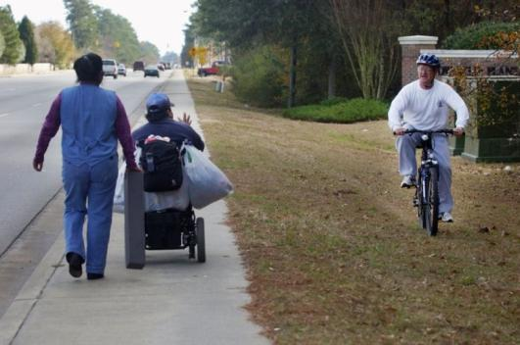
Key research findings
Living in Communities that Support Healthy Eating and Active Living could…
Generate 2 more walk/bike trips per person per week
Prevent up to 1.7 pounds of weight gain per year; 35% lower risk of obesity
Increase total minutes of physical activity (40% more)
Increase fruit and vegetable consumption. Black Americans' fruit and vegetable intake increased 32 % for each additional supermarket in their neighborhood
Increase life expectancy by 4 years
Ewing et al 2003, Saelens et al 2003, Giles-Corti 2003, Frank et al 2003, Sturm et al 2004, Frank et al 2004, Lopez 2004, Morland et al 2002
Notes:
(Talking points)
What kind of research supports the community-approach to health? Recent research shows us that living in healthy communities (compact communities with mixed use activity centers within walking distance like so many of those generally built before WWII as well as ample access to healthy foods), could…
Generate more walk/bike trips per person per week
Help prevent weight gain
Positively affect walking/cycling for transport
Help impact the total minutes of physical activity
Increase fruit and vegetable consumption
And may even increase life expectancy
______________________________
[Background/references]
Reference for fruit and veggie consumption:
Morland, K., Wing, S., & Diez Roux, A. (2002). The contextual effect of the local food environment on residents' diet: The atherosclerosis risk in communities study. American Journal of Public Health. 92(11): 1761-1767
For active living data:
Ewing et al 2003,
Saelens et al 2003,
Giles-Corti 2003,
Frank et al 2003,
Lopez 2004

Slide 9
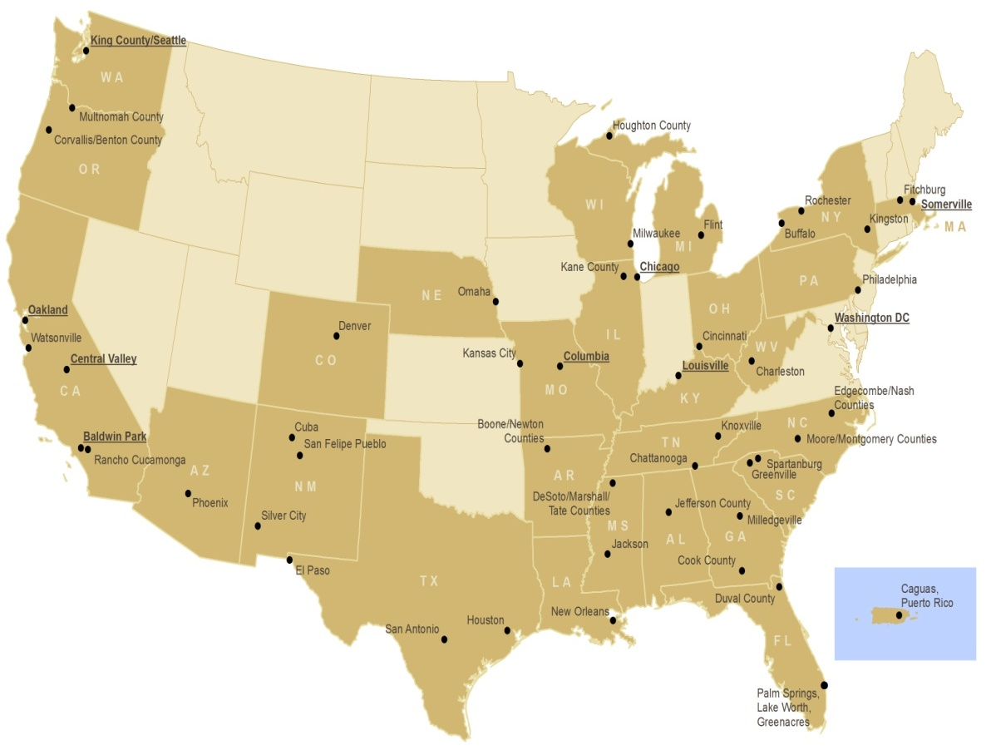
Healthy Kids, Healthy Communities
The Program
$33 million over 5 years
50 sites across the nation
Active living and healthy eating
Policy and environmental change
Children and families
Low-income, vulnerable populations
The Partnership
HKHC NPO and RWJF
Local funders
HKHC Leading Sites
RWJF Center to Prevent Childhood Obesity and other partners

Slide 10
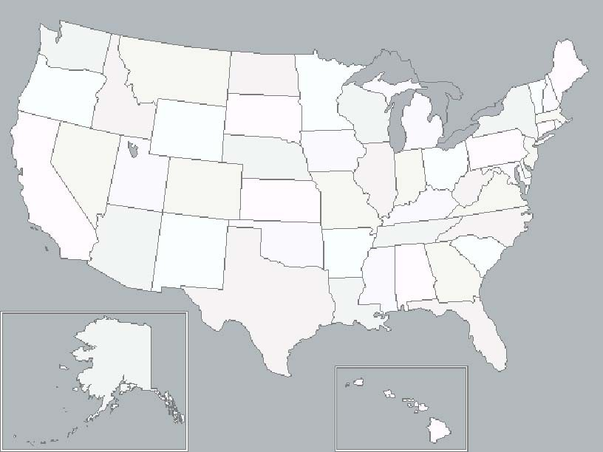
Healthy Kids, Healthy Communities (50 Grantees)
HKHC Leading Site Communities
King County/Seattle, WA
Multnomah County, OR
Houghton, MI
Benton County, OR
Rochester, NY
Fitchburg, MA
Milwaukee, WI
Buffalo, NY
Somerville, MA
Flint, MI
Kingston, NY
Kane County, IL
Chicago, IL
Philadelphia, PA
Oakland, CA
Omaha, NE
Denver, CO
Hamilton County, OH
Washington, DC
Watsonville/Parajo Valley, CA
Kansas City, MO
Charleston, WV
Central Valley, CA
Columbia, MO
Louisville, KY
Baldwin Park, CA
Cuba, NM
Knoxville, TN
Nash/Edgecombe Counties, NC
Rancho Cucamonga, CA
Chattanooga, TN
Moore/Montgomery Counties, NC
San Felipe Pueblo, NM
Boone/Newton Counties, AR
Greenville, SC
Phoenix, AZ
Desoto/Marshall/ Tate Counties, MS
Jefferson County, AL
Spartanburg, SC
Silver City, NM
Milledgeville, GA
El Paso, TX
Jackson, MS
Cook County, GA
San Antonio, TX
Houston, TX
New Orleans, LA
Duval County, FL
Lake Worth/Greenacres/ Palm Springs, FL
Caguas, PR
Healthy Kids,
Healthy Communities
Notes:
RWJF’s Healthy Kids, Healthy Communities, based in part on the tremendous success of the original ALBD program launched in 2003, works with 50 communities across the United States to address the childhood obesity epidemic in populations at greatest risk. It is an important part of RWJF’s commitment to reversing the childhood obesity epidemic by 2015 and I believe it’s the largest single investment in community-level change ever made by the Foundation. I’m pleased to say that Kansas City – under the leadership of KC Healthy Kids – is one of the sites. HKHC gives us the change to build on the learning from previous initiatives, scale up what works, and expand the reach partnership-based, environmental and policy change approaches to public health. We saw the growing level of capacity and potential here, the significant need for investment and wanted to join forces with the regional and local supporters who have built a great foundation and made bigger things possible here.

