Slide 1
Donna Rice, MBA, RN, CDE, FAADE
Healthy Communities: The Intersection of Community Development and Health Federal Reserve Bank of Dallas, Houston Branch Houston, Texas
September 28, 2011

Slide 2
Mission Statement
To improve the care and save lives of people with diabetes by creating a new care model focused on health care, education, and research in
South Dallas.

Slide 3
Fundamental Principles
Key Factors:
Public and private partnership between the City of Dallas and Baylor Health Care System
Integration of social, cultural, medical, and economic initiatives
Innovative approaches to care of diabetes and other related conditions
Incorporation of community-based, multi-disciplinary research to understand the needs of the community

Slide 4
Health Equity Improvement Model

Slide 5
SSHI Market: Demographics
Frazier Community Demographics (2005)
Population – 33,607 (46% M; 54% F)
Race – 84% AA; 14% H; 1% W; 1% O
Avg. Per Capita Income - $9,000
(Dallas Avg. - $24,444)
Efforts will target South Dallas

Slide 6
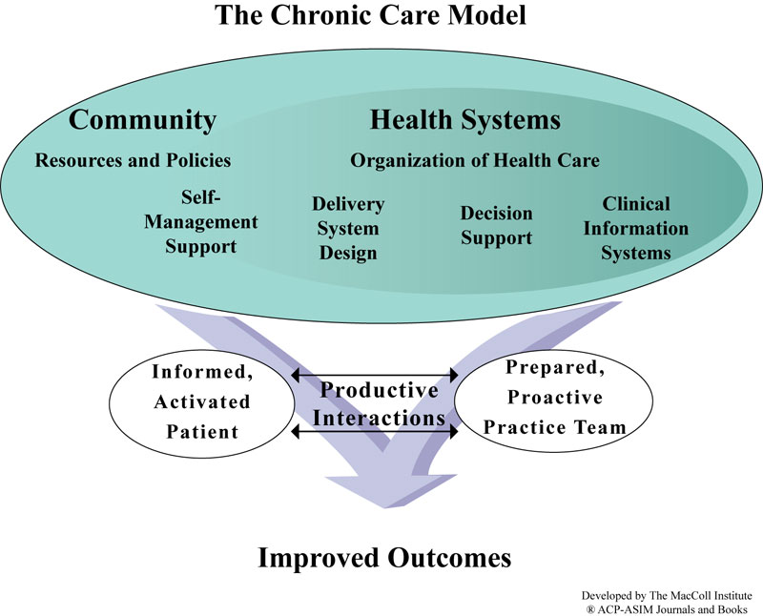

Slide 7
Measuring Outcomes
Outcome | Measure
Glycemic Control | Hemoglobin A1C
Health Indicators | Blood Pressure Body Mass Index (BMI) Urine Microalbumin Lipid Levels Flu/pneumonia
Achievement of ADA/Medicare Standards of Care AADE 7 Self care Behaviors | Clinical, process measures, Eye and foot exam Behavior change -Interventions/barriers
Quality of Life Satisfaction | Diabetes QOL Survey Patient Centeredness
Patient Participation Rates | Enrolled, % participation, drop-outs /no show rates
Health care cost | BHCS/BUMC inpatient/ED direct cost analysis/health outcomes

Slide 8
Demographics
Race/Ethnicity (n=2081) |  |  | Gender (n=2099)
African American | 1424 |  | Male | 578
Non-white Hispanic | 412 |  | Female | 1521
White/Hispanic | 123 |  | Age
White | 84 |  | Mean (std) | 50 (14.7) yr
Black/Hispanic | 36 |  | Min | 18 yr
Other | 20 |  | Max | 95 yr

Slide 9
Demographics
Insurance
Uninsured |  |  | 54.4% |  | Medicare |  | 5.5% | Medicaid | 1.4%
Insured |  |  | 29.3% |  | Refused |  | 3.9%
Diabetes Type (for those who reported having diabetes n=1002)
Type 1 | 2.3% | Type 2 |  | 95.2% |  | Pre-diabetes or gestational |  |  | 2.5%

Slide 10
Enrollment by Month
μ₂₀₁₀ = 162 per month
μ₂₀₁₁ = 135 per month

Slide 11
Program Visits by Month
μ₂₀₁₀ = 677 per month
μ₂₀₁₁ = 758 per month

Slide 12
Quality of Life
EQ-5D
 | No Problems | Some Problems | Many Problems
Mobility | 56.8% | 36.5% | 6.7%
Self-care | 91.0% | 8.1% | 0.9%
Usual Activities | 71.2% | 25.4% | 3.4%
Pain/Discomfort | 34.1% | 55.4% | 10.5%
Anxiety/Depression | 56.8% | 36.5% | 6.7%
Visual Analog Scale
On a scale from 0 (worst imaginable health state) to 100 (best imaginable health state) , indicate how good or bad your health is today.
 | Mean | Std | Median | Mode
 | 66.4 | 21 | 70 | 80

Slide 13
Standards of Medical Care in DM
A1c <7.0% n=199
 | Meets | Does Not Meet
Baseline | 47.2% | 52.8%
Follow-Up | 63.3% | 36.7%
Blood Pressure <130/80 mmHg n= 307
 | Meets | Does Not Meet
Baseline | 32.6% | 67.4%
Follow-Up | 39.4% | 60.6%

Slide 14
Standards of Medical Care in DM
Total Cholesterol <200 mg/dL n=1421 at baseline; n=184 at F/U
 | Meets | Does Not Meet
Baseline | 70.0% | 30.0%
Follow-Up | 60.9% | 39.1%
Triglycerides <150 mg/dL n=1400 at baseline; n=181 at F/U
 | Meets | Does Not Meet
Baseline | 49.9% | 50.1%
Follow-Up | 44.2% | 55.8%
HDL-C >40 mg/dL n= 1384 at baseline; n=182 at F/U
 | Meets | Does Not Meet
Baseline | 62.3% | 37.6%
Follow-Up | 60.4% | 39.6%
LDL-C <100 mg/dL n=1275 at baseline; n=163 at F/U
 | Meets | Does Not Meet
Baseline | 50.6% | 49.4%
Follow-Up | 46.0% | 54.0%

Slide 15
Participant Attendance
No-show rates for biometric screenings and health partner visits and cumulative totals of participants by fiscal quarter
FY11 (July 2010 – June 2011) |  |  |  | FY12 (July 2011 – June 2012)†
 | Biometric Screening | Health Partner | n |  | Biometric Screening | Health Partner | n
Q1 | - | - | 501 | Q1 | 6% | 18% | 1696
Q2 | 0% | 35% | 870 | Q2 | - | - | -
Q3 | 10% | 29% | 1094 | Q3 | - | - | -
Q4 | 30% | 22% | 1499 | Q4 | - | - | -
†FY12 only contains data through July and not the entire 1st quarter

Slide 17
Diabetes Health & Wellness Institute at the Juanita J. Craft Center
Wellness Center
Primary & Secondary Tertiary Prevention
Clinic
Secondary & Tertiary Prevention
Parks & Recreation
Primary Prevention
Recreation/Lifestyle Programs w
Health Messaging
Community Based
Research Agenda
Physician directed, team
led, empowerment model
Health Risk Appraisals
Train the Trainer Programs
Disease state management
Disease State Management/ NCQA Recognized/employee health
Health & Wellness Programs –
Nutrition, Exercise, Stress Management
Behavior Modification
Health Screenings
Health coaches
Peer Led Self-Management Support
For People With Diabetes
Comprehensive Education
AADE Education recognized
Diabetes Self-Management Training (DSMT)
Medical Nutrition Therapy (MNT)
Health Screenings – Prevention/Fairs
(Identifying People at Risk)
Individual Enrichment Classes
Adult/Youth Education
Tutoring
Care Coordination:
Referrals to education or social services and other services
Speakers’ Bureau

Slide 18
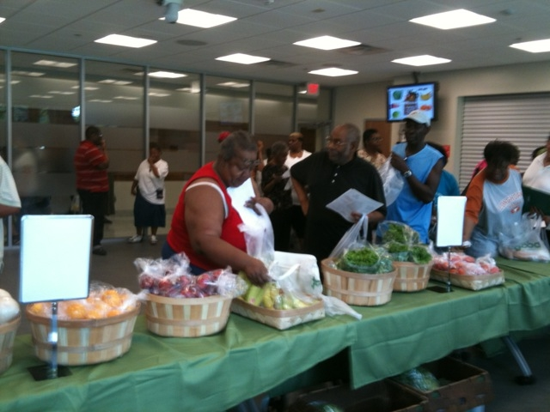
Weekly Farm Stand

Slide 20
Questions ?

