Slide 1

Janie Barrera
President & CEO
ACCION Texas
2014 S. Hackberry
San Antonio, TX 78210
210.507.4283 Direct Line
jbarrera@acciontexas.org
www.acciontexas.org

Slide 2
Entrepreneurship
“Social entrepreneurs are not content just to give a fish or teach how to fish. They will not rest until they have revolutionized the fishing industry.”
(Bill Drayton, CEO, chair and founder of Ashoka)

Slide 3
One in Three
If one in three microbusinesses in the United States hired an additional employee, the US would be at full employment

Slide 4
What is microfinance?
The practice of offering small loans and other financial services to low-income people to help them increase their incomes through entrepreneurship and self-employment.

Slide 5
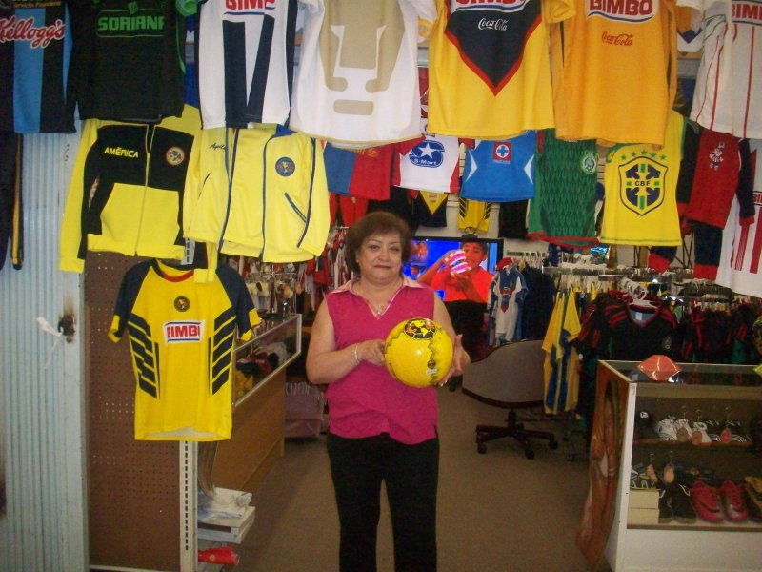
How microfinance works
Maria Cortes de la Torre
Maria Luisa Sport
Dallas, Texas
Loan features—including size, collateral requirements, and repayment terms—typically are more flexible than those of standard bank loans and are tailored to the needs of low- and moderate-income entrepreneurs.

Slide 6

Why do Business Owners need Access to Capital?
Accounting and Financial System
Inventory
Equipment
Marketing/Advertising
Expansion of Work Force

Slide 7
Microfinance’s impact
Access to capital helps businesses grow, contributing more to local economy
Business development services teach self-reliance to stabilize and sustain businesses. More profits and good repayment histories make businesses more attractive
to traditional banks.
Improved prosperity
helps families

Slide 8
Value Proposition
Loan
Entrepreneur
Sustainability

Slide 9

ACCION Texas Inc. was established in San Antonio in 1994.
Founding president still leads it today.
A leader in the U.S. microfinance industry in providing financial and business-development services, but also in efforts to help the industry reach scale.

Slide 10

ATI’s service area
Notes:
10

Slide 11
Impact As of June 2011
11,717 loans
$113 million disbursed
$28 million outstanding portfolio
2,280 active borrowers
$149 million in economic activity
$48.8 million in increased wages
$8.7 million in tax revenue
2,000 new jobs
4,000 sustained jobs
70 plus employees

Slide 12
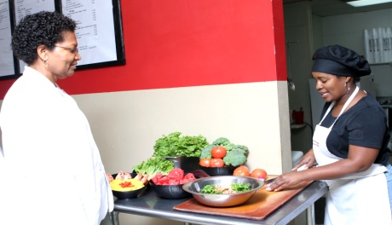
Arga Bourgeouis
Sunfired Foods
Houston, Texas
In 2004 with a $13,000 loan from ACCION Texas Inc., Arga Bourgeouis opened up Sunfired Foods in the third ward of Houston, thus fulfilling a life-long commitment to improving the health and lifestyles of those around her. With other loans from ACCION Texas, Arga has been able to expand her product lines to customers, provide workshops, hire new employees and improve her working capital.
Now, Sunfired Foods is not only a full health-food store, selling herbs, vitamins, vegetarian and organic cuisine and nutritional products traditionally unavailable to low-income individuals, but has also become the neighborhood’s information source for pursuing a healthy lifestyle.

Slide 13
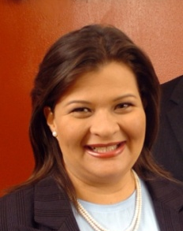
In 2003, Colombian immigrant Claudia Mirza had an idea to provide high quality translation services to area businesses and conceived Akorbi Translation Services. With no credit history and unable to get a bank loan, Claudia turned to ACCION Texas Inc. for a $13,000 loan to grow the business at a critical time.
Now in 2009, Akorbi Translation Services has annual earnings of almost $2 million. With offices in the Dallas, Colombia and 60 freelance professional translators all over the world, Akorbi has grown into a prosperous international business.
Claudia Mirza
Akorbi Translation Services
Dallas, Texas

Slide 14
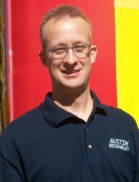
Kevin Baldtree
Austin Moonwalks
Round Rock, Texas
In 2005, Kevin Baldtree, while still holding a full-time job, operated Austin Moonwalks as a part-time business providing moonwalk rentals at about 500 events a year. Wanting to expand his business and purchase additional inventory, Kevin came to ACCION Texas Inc. for a $10,000 loan and then later an additional $12,000 loan to meet the demand in the market.
Today, Kevin, working full-time with 4 additional part-time staff, provides party rental equipment at over 1,000 events to include birthday parties, school fairs and other community venues. Austin Moonwalks expects to hit $250,000 in sales this year while assisting his Greater Austin area clients with happy and fun-filled events.

Slide 15
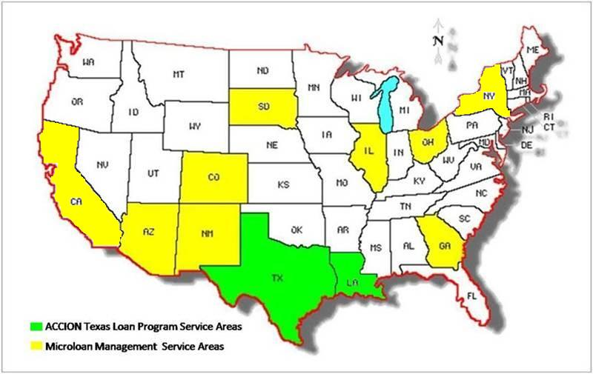
ACCION Texas Inc. Loan & Micro-Loan Management Service Areas

Slide 16
Solution
17 years of making loans in Texas and now serving seven other states
Disbursed more than $112 Million
Integrated corporate incentives in non-profit world
Streamlined loan process – just the essentials

Slide 17
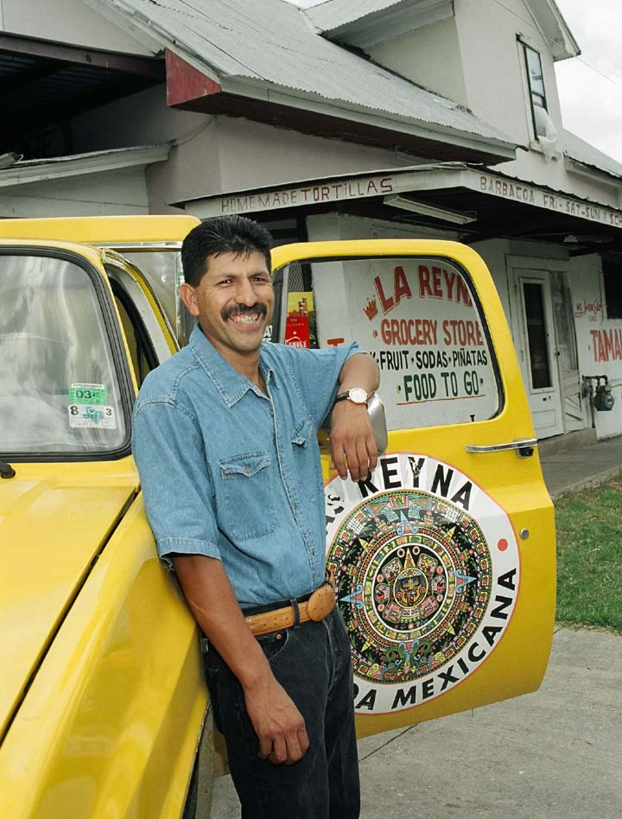
ACCION Texas Inc.
Philosophy
Credit, a word which comes from the Latin verb “to believe,” is what ACCION is all about. Giving people credit for who they are and seeing collateral in a person’s character. Believing that people can succeed, and giving them the tools they need to do so.
Moises Reyna
Owner, Tienda La Reyna

Slide 18
Contact
Janie Barrera
President & CEO
ACCION Texas
2014 S. Hackberry
San Antonio, Tx 78210
210.507.4283 Direct Line
jbarrera@acciontexas.org
www.acciontexas.org

