Slide 1
Health Impact Assessment: Incorporating Health into Community Development Kara Vonasek, M.P.H. Project Manager Health Impact Project www.healthimpactproject.org

Slide 2
Outline
Context for HIA
What is HIA?
Steps of HIA
Examples of HIA
Key Points about HIA

Slide 3
“Get more exercise”...

Slide 4
“Eat more fresh fruits and vegetables” . . .

Slide 5
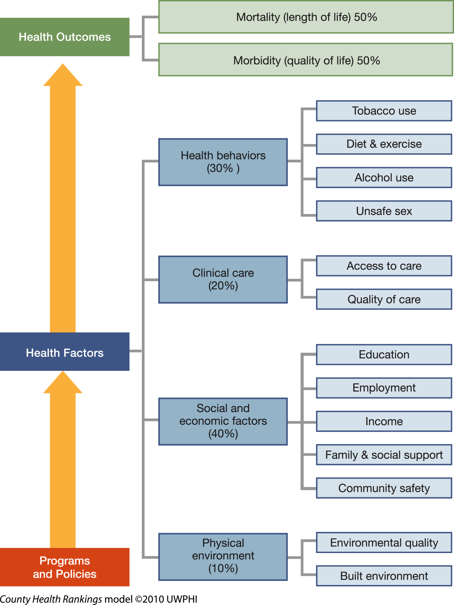
County Health Rankings
RWJF and University of Wisconsin Madison: www.countyhealthrankings.org/about-project/background

Slide 6
HIA Addresses Determinants of Health
affect
Housing
Air quality
Noise
Safety
Social networks
Nutrition
Parks and natural space
Private goods and services
Public services
Transportation
Livelihood
Water quality
Education
Inequities
How does the proposed
project, plan, policy
and lead to health outcomes

Slide 7
Definition of HIA
HIA is a systematic process that uses an array of data sources and analytic methods and considers input from stakeholders to determine the potential effects of a proposed policy, plan, program, or project on the health of a population and the distribution of those effects within the population. HIA provides recommendations on monitoring and managing those effects.
[National Academies, National Research Council (NRC) Report: Committee on Health Impact Assessment]

Slide 8
The HIA Process
Screening: establishes the need for and value of conducting an HIA
Scoping: identifies the populations that might be affected, determines which health effects will be evaluated in the HIA
Assessment: describes baseline health conditions of affected populations; characterizes expected health effects of the proposal relative to the baseline
Recommendations: identifies alternatives to the proposal or specific actions that could be taken to avoid, minimize, or mitigate adverse effects AND maximize health benefits of a proposal
Reporting: communicates findings and recommendations to decision-makers, the public, and other stakeholders
Monitoring and Evaluation: monitors results of HIA, monitors health outcomes; evaluates the HIA process

Slide 9
Key Points About HIA
HIA works in the setting of real time planning and decision-making.
It’s flexible – explicitly intended to fit the timeline of the decision
It’s solutions-oriented and realistic
Occurs early in planning process – so that recommendations can be implemented without excessive costs
Can actually speed approval of a project/decision
HIA is not for EVERY decision
Should only be done if it is likely to add information that will lead to a better decision
Most HIAs aren’t all that expensive—primarily staff time
Also takes a champion willing to spearhead effort

Slide 10
HIA Ex: Jack London Gateway Development
Authors: Human Impact Partners & SFDPH
Decision: Plan for 61 new senior housing units close to 2 freeways & Port of Oakland
Impacts: Air quality; noise; safety; retail access
Recommendations: Noise-insulating windows; pedestrian protection medians; traffic calming measures; air quality monitoring; installation of ventilation systems; and many others
Outcomes:
Many recommendations adopted
Additional HIA projects were funded
Healthy Development Checklist adopted by the development committee

Slide 11
HIA Ex: Page Avenue Revitalization
Authors: Washington University in St. Louis
Decision: Addressed a $45-million community redevelopment project in the City of Pagedale, Missouri
Impacts: Employment; access to goods
& services, healthy foods, recreation; pedestrian safety; community safety; community identity; housing
Recommendations:
Improve pedestrian infrastructure
Recruit businesses that hire locally
Space for community marketplace
Adopt healthy food zone ordinance
Prioritize spaces & programs for
youth recreation
Demolish vacant buildings & plant
orchards as interim infill
Integrate affordable & market rate
housing units
Design buildings for mixed use

Slide 12
Ex. HIAs in Texas and New Mexico
Highway 550 – Cuba, New Mexico
A rapid HIA looked at the impacts of proposed highway improvements on community health, downtown walkability, pedestrian safety, social cohesion and economic development.
School Siting Policies – Austin, TX
An HIA with a focus on how school siting affects whether children walk, bike, or use motorized transportation to get to school.
Transit Oriented Development – Houston, TX
An HIA to examine the health impacts of possible development patterns that could occur in the neighborhood near a planned station on a 30-mile, five-corridor light rail expansion.

Slide 13
What HIA is not . . . What HIA is
It’s not used to make the case for why a policy, program or project should be proposed.
It’s not an assessment to understand the impacts of a program or policy once it has been implemented.
The Sweet Spot – It’s proactive! It’s meant to inform a proposed policy, program or project currently under active consideration by a decision-making body.
It’s not a community assessment tool (i.e., MAPP, CHIP, CHA), but those are used during assessment stage of HIA.
HIA is the framework that translates that data into well-informed policies.

Slide 14
The Business Case for HIA Development lending and international business
World Bank and IFC: part of evaluation standards for large development loans
Equator Principles
Multinational Corporations:
e.g.; Shell, Chevron, large mining
Companies. Why?
Lower business costs
Corporate social responsibility
Healthy workforce
Risk management
“Companies should use health impact assessments with a simple goal in mind: to leave communities healthier than when they found them. A mine cannot be successful without a healthy local workforce and the support of the community in which it operates.”
ICMM, 2010

Slide 15
Key Points About HIA
It’s an effective tool for meaningful cross-sector collaboration
The best way to learn HIA is just to do one!
Legacy of HIA:
Relationships/trust is built among partners
Increased stakeholder understanding of value of HIA
Increases likelihood of doing another HIA in future and routine consideration of health in decision making

Slide 16
Discussion?
Kara Vonasek
kvonasek@pewtrusts.org
Phone: 202.540.6379
www.healthimpactproject.org

